Slide 1
session 9 – key points
9
social identity theory & group memberships
value of ‘weak’ social ties
Barbara Fredrickson, love 2.0 & interaction quality
continuing to work with overall social networks & the affect dyad exercise
remembering self-care, mindbus, savouring, work

Slide 2
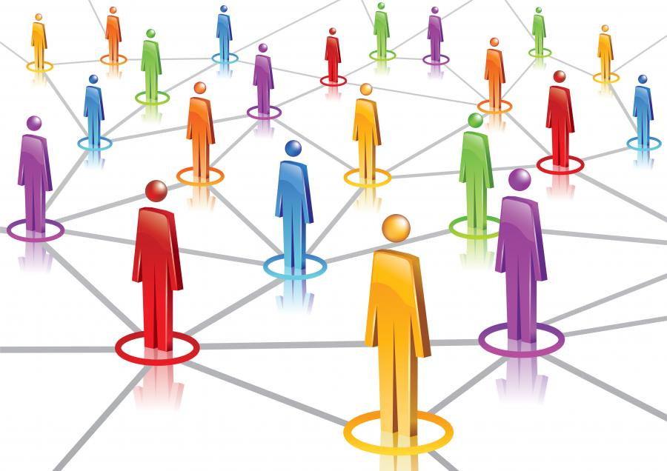
social identity theory
Haslam, C., et al. (2019). "The importance of social groups for retirement adjustment." Social Issues and Policy Review 13(1): 93-124.
Haslam, S. A., et al. (2018). "Social cure, what social cure? The propensity to underestimate the importance of social factors for health." Social Science & Medicine 198: 14-21.
Slater, M. J., et al. (2018). "Singing it for “us”: team passion displayed during national anthems is associated with subsequent success." European Journal of Sport Science: 1-9.
Jetten, J., et al. (2017). "Advancing the social identity approach to health & well‐being: Progressing the social cure research agenda." European Journal of Social Psychology 47(7): 789-802.
Sani, F., et al. (2015). "Greater number of group identifications is associated with lower odds of being depressed: evidence from a Scottish community sample." Social Psychiatry and Psychiatric Epidemiology 50(9): 1389-1397
Sani, F., et al. (2012). "Comparing social contact and group identification as predictors of mental health." Br J Social Psychology 51(4): 781-790.
social identity
and groups network
ww.socialidentitynetwork.com

Slide 3
social identity mapping
identify the various groups you belong to
rate into three categories of importance (post-it sizes)
how positive about being a member (1 to 10)?
frequency of meetings & duration of membership
how representative of the group do you feel you are?
intergroup distance & inter-group membership conflict?
Cruwys, T., et al. (2016). "Social identity mapping: a procedure for visual representation and assessment of subjective multiple group memberships." British Journal of Social Psychology 55(4): 613-642.

Slide 4
research on ‘weak social ties’
in general close relation-ships are better for our health & wellbeing than more distant ones, but …
we tend to underestimate the wellbeing boost of chat with (comparative) strangers (shop, cafe, neighbour, etc)
typically more beneficial for us (& them) if we are more authentic, unguarded, warm
helpful both for wellbeing and also for physical health
Appau, S., et al. (2019). "Social integration & subjective wellbeing." Applied Economics 51(16): 1748-1761.
Deri, S., et al. (2019). "With a little help from my friends (and strangers)." Journal of Experimental Social Psychology 82: 6-15.
Epley, N. and J. Schroeder (2014). "Mistakenly seeking solitude." Journal of Experimental Psychology: General 143(5): 1980-1999.
Sandstrom, G. M. and E. W. Dunn (2014). "Social interactions and well-being: The surprising power of weak ties." Personality and Social Psychology Bulletin 40(7): 910-922.

Slide 5
explore being more friendly
experiment with being a bit more friendly, outgoing, warm, chatty – how is it?
research highlights that if you find the interaction pleasant, the others invol-ved are likely to as well
connection to neighbours and neighbourhood adds to everyone’s wellbeing
shops, queues, cafes, journeys – chat a little more openly & observe the effects on you & others

Slide 6
barbara fredrickson’s “love 2.0: creating happiness & health in moments of connection”
“The Eskimos had 52 names for snow because it was important to them; there ought to be as many for love.”
Margaret Atwood
“Love doesn't just sit there, like a stone; it has to be made, like bread, remade all the time, made new.”
Ursula K. Le Guin
love as moments of caring, emotional synchronisation

Slide 7
practising ‘positivity resonance’
goodwill
sharing ‘positive’(?) emotion
synchronisation
aim for at least 3 ‘connections’ daily
scale record closeness & synchronisation
significant gains in ‘positivity ratio’
Barbara Fredrickson “Love 2.0” Plume, 2014

Slide 8
session 9 – key points
9
social identity theory & group memberships
value of ‘weak’ social ties
Barbara Fredrickson, love 2.0 & interaction quality
continuing to work with overall social networks & the affect dyad exercise
remembering self-care, mindbus, savouring, work

Slide 9
sympathy group/good relationships
on average – including those in the ‘support clique’ - there are roughly 15 people in the ‘sympathy group’ – they are not so deeply close as those who are also in the ‘clique’ and are probably seen about monthly rather than approximately weekly for the ‘clique’
the ‘sympathy group’ are described as people who would be ‘devastated’ by the death of someone else in the group
typically there are about 3 x as many people in the ‘sympathy group’ as in the ‘support clique’ – and in both there are usually a considerably higher proportion of same sex contacts; people from large families may not have much time/space left in their sympathy group for non-family friends
emotional closeness changes & it takes time & regular contact to maintain – this is especially true for non-family friendships
10 =
intensely close/intimate
although both ‘sympathy group’ & ‘support clique’ numbers are limited by available time – the size of the latter is also dependent on mentalising ability (perspective –taking competence), while the former possibly depends more on memory capacity
0 =
emotionally neutral

Slide 10
affinity groups & active networks
on average there are about 150 people in a personal full ‘active network’ – with a natural range of approximately 100-250; it correlates with pre-industrial village size & earlier tribal size; the active network may well serve both territorial & mate-access functions
one’s full ‘active network’ is made up mostly of ‘acquaintances’ - all the people with whom one has a ‘personalized’ relationship and who one wants to maintain contact with
successive network layers increase in numbers by a factor of about 3, and tend to involve relationships that demand less time investment to maintain & that are less emotionally close – however different layers respond to different needs
the smaller – approximately 50 sized – affinity or foraging group probably primarily has an anti-predation function
10 =
intensely close/intimate
social identity theory (haslam, cruwys, et al) highlights the considerable health gains obtainable through identification & participation with a variety of groups, that may be populated by acquaintances rather than friends
0 =
emotionally neutral

Slide 11
course outline/our journey
values, self-determination
mindset, exercise & sleep
willpower, diet, dependencies
mindbus & coping responses
savouring & gratitude
work, strengths, expertise
roles, dunbar, needs, dyads
nourishing, conflict, wisdom
groups, weak ties, resonance
review & stepping forward

Slide 12
values, needs & goals: how are you doing?
revisit question-naires, course notes & intentions

