Slide 1
session 9 – key points
9
social identity theory & group memberships
value of ‘weak’ social ties
Barbara Fredrickson, love 2.0 & interaction quality
continuing to work with overall social networks & the affect dyad exercise
remembering self-care, mindbus, savouring, work

Slide 2
course outline/our journey
values, self-determination
mindset, exercise & sleep
willpower, diet, dependencies
mindbus & coping responses
savouring & gratitude
work, strengths, expertise
roles, dunbar, needs, dyads
nourishing, conflict, wisdom
groups, weak ties, resonance
review & stepping forward

Slide 3
session 8 – key points
‘nourishing’ relationships: ‘knowledge’ & ‘intelligence’
touch and sex
conflict and wisdom
‘attachment’ and other innate behavioural systems
continuing to work with overall social networks & the affect dyad exercise

Slide 4

the six ‘rules’ of friendship
stand up for them when they’re absent
share important news with each other
trust and confide in each other
volunteer help when it would be useful
provide emotional support for each other
try to make each other happy
the six rules were derived from 4 studies involving British, Italian, Hong Kong and Japanese participants
Argyle, M. & M. Henderson (1984). "The rules of friendship." Journal of Social and Personal Relationships 1(2): 211-237.

Slide 5
some intriguing take-away points
knowledge and communication emerged as particularly helpful ways of nourishing close relationships – this is probably true for good friendships as well as for couples
knowledge of partner: knowing how to have fun with one’s partner, knowing about his/her preferences, caring about one’s partners hopes and dreams, etc
communication: knowing how to listen, sharing one’s thoughts & feelings honestly, refraining from criticizing, etc
knowledge: finding out about, remembering & referring to important aspects of the other’s life seems important and learnable; communication: crucial as well, although maybe we should be cautious on our self-assessment here

Slide 6
interesting recent sex research
Muise, A., et al. (2019). "Broadening your horizons: Self-expanding activities promote desire and satisfaction in established romantic relationships." Journal of Personality and Social Psychology 116: 237-258.
Jackson, S. E., et al. (2019). "Decline in sexuality and wellbeing in older adults: A population-based study." Journal of Affective Disorders 245: 912-917.
Mark, K. P. and J. A. Lasslo (2018). "Maintaining sexual desire in long-term relationships: systematic review." The Journal of Sex Research 55(4-5): 563-581.
Maxwell, J. A., et al. (2017). "How implicit theories of sexuality shape sexual and relationship well-being." J Pers Soc Psychol 112(2): 238-279.
Debrot, A., et al. (2017). "More than just sex: affection mediates the association between sexual activity and well-being." Pers SocPsychol Bulletin 43(3): 287-299.
Arnocky, S., et al. (2017). "Altruism predicts mating success in humans." British Journal of Psychology 108(2): 416-435.
Twenge, J. M., et al. (2016). "Changes in American adults' reported same-sex sexual experiences and attitudes, 1973-2014." Arch Sex Behav 45(7): 1713-1730.
Lammers, J. and R. Imhoff (2016). "Power and sadomasochism: understanding the antecedents of a knotty relationship." Soc Psychol Personal Science 7(2): 142-148.
Muise, A., et al. (2015). "Sexual frequency predicts greater well-being, but more is not always better." Social psychological and personality
Joyal, C. C., et al. (2015). "What exactly Is an unusual sexual fantasy?" The Journal of Sexual Medicine 12(2): 328-340
Johnson, M. D., et al. (2015). "Skip the dishes? Not so fast! Sex and housework revisited." J Fam Psychol
Adam, F., et al. (2015). "Mindfulness skills are associated with female orgasm?" Sexual and Relationship Therapy 30(2): 256-267

Slide 7
interesting recent touch research
Triscoli, C., et al. (2019). "Depression predicts interpersonal problems partially through the attitude towards social touch." Journal of Affective Disorders 246: 234-240.
Sekerdej, M., et al. (2018). "Keeping in touch with context: Non-verbal behavior as a manifestation of communality and dominance." Journal of Nonverbal Behavior 42(3): 311-326.
Jakubiak, B. K. and B. C. Feeney (2017). "Affectionate touch to promote relational, psychological, and physical well-being in adulthood: A theoretical model and review of the research." Personality and Social Psychology Review 21(3): 228-252.
Nummenmaa, L., et al. (2016). "Social touch modulates endogenous mu-opioid system activity in humans." Neuroimage.
Jakubiak, B. K. and B. C. Feeney (2016). "A sense of security: touch promotes state attachment security." Social Psychological and Personality Science 7(7): 745-753.
Jakubiak, B. K. and B. C. Feeney (2016). "Keep in touch: The effects of imagined touch support on stress and exploration." Journal of Experimental Social Psychology.
Suvilehto, J. T., et al. (2015). "Topography of social touching depends on emotional bonds between humans." Proceedings of the National Academy of Sciences.
Robinson, K. J., et al. (2015). "When in doubt, reach out: touch Is a covert but effective mode of soliciting and providing social support." Social Psychological and Personality Science 6(7): 831-839.
Cohen, S., et al. (2015). "Does hugging provide stress-buffering social support? A study of susceptibility to upper respiratory infection and illness." Psychological Science 26(2): 135-147.

Slide 8

friendship & conflict
540 participants (only 112 were male)
all adults - 70% were aged between 18 & 38
363 were currently in a couple relationship
asked about ‘severe fallings out’ with people in their social network
last week/month/year
40% still not reconciled a year afterwards
conflicts with those who matter most to us in our personal social networks are surprisingly common
Dunbar, R. & A. Machin (2014). "Sex differences in relationship conflict and reconciliation." Journal of Evolutionary Psychology 12(2-4): 109-133.

Slide 9

attachment: care-seeking situations

Slide 10
other ‘intrinsic’ behavioural systems
care-seeking
care-giving
exploration
sex
power
about right?
too hot?
too cold?

Slide 11
session 9 – key points
9
social identity theory & group memberships
value of ‘weak’ social ties
Barbara Fredrickson, love 2.0 & interaction quality
continuing to work with overall social networks & the affect dyad exercise
remembering self-care, mindbus, savouring, work

Slide 12
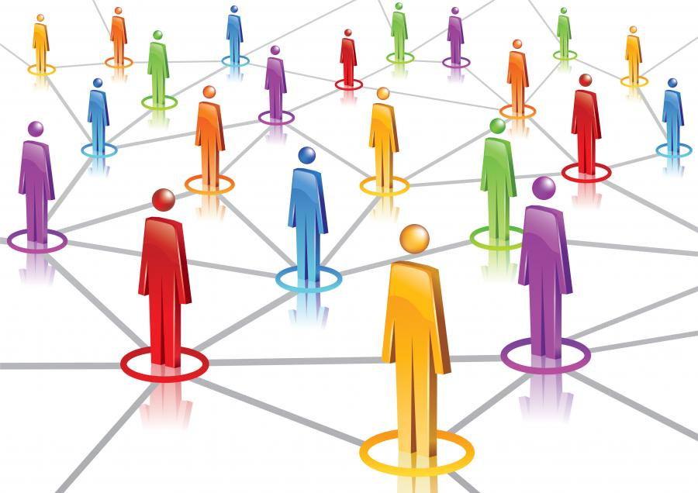
social identity theory
Haslam, C., et al. (2019). "The importance of social groups for retirement adjustment." Social Issues and Policy Review 13(1): 93-124.
Haslam, S. A., et al. (2018). "Social cure, what social cure? The propensity to underestimate the importance of social factors for health." Social Science & Medicine 198: 14-21.
Slater, M. J., et al. (2018). "Singing it for “us”: team passion displayed during national anthems is associated with subsequent success." European Journal of Sport Science: 1-9.
Jetten, J., et al. (2017). "Advancing the social identity approach to health & well‐being: Progressing the social cure research agenda." European Journal of Social Psychology 47(7): 789-802.
Sani, F., et al. (2015). "Greater number of group identifications is associated with lower odds of being depressed: evidence from a Scottish community sample." Social Psychiatry and Psychiatric Epidemiology 50(9): 1389-1397
Sani, F., et al. (2012). "Comparing social contact and group identification as predictors of mental health." Br J Social Psychology 51(4): 781-790.
social identity
and groups network
ww.socialidentitynetwork.com

Slide 13
social identity mapping
identify the various groups you belong to
rate into three categories of importance (post-it sizes)
how positive about being a member (1 to 10)?
frequency of meetings & duration of membership
how representative of the group do you feel you are?
intergroup distance & inter-group membership conflict?
Cruwys, T., et al. (2016). "Social identity mapping: a procedure for visual representation and assessment of subjective multiple group memberships." British Journal of Social Psychology 55(4): 613-642.

Slide 14
session 9 – key points
9
social identity theory & group memberships
value of ‘weak’ social ties
Barbara Fredrickson, love 2.0 & interaction quality
continuing to work with overall social networks & the affect dyad exercise
remembering self-care, mindbus, savouring, work

Slide 15
research on ‘weak social ties’
in general close relation-ships are better for our health & wellbeing than more distant ones, but …
we tend to underestimate the wellbeing boost of chat with (comparative) strangers (shop, cafe, neighbour, etc)
typically more beneficial for us (& them) if we are more authentic, unguarded, warm
helpful both for wellbeing and also for physical health
Appau, S., et al. (2019). "Social integration & subjective wellbeing." Applied Economics 51(16): 1748-1761.
Deri, S., et al. (2019). "With a little help from my friends (and strangers)." Journal of Experimental Social Psychology 82: 6-15.
Epley, N. and J. Schroeder (2014). "Mistakenly seeking solitude." Journal of Experimental Psychology: General 143(5): 1980-1999.
Sandstrom, G. M. and E. W. Dunn (2014). "Social interactions and well-being: The surprising power of weak ties." Personality and Social Psychology Bulletin 40(7): 910-922.

Slide 16
explore being more friendly
experiment with being a bit more friendly, outgoing, warm, chatty – how is it?
research highlights that if you find the interaction pleasant, the others invol-ved are likely to as well
connection to neighbours and neighbourhood adds to everyone’s wellbeing
shops, queues, cafes, journeys – chat a little more openly & observe the effects on you & others

Slide 17
session 9 – key points
9
social identity theory & group memberships
value of ‘weak’ social ties
Barbara Fredrickson, love 2.0 & interaction quality
continuing to work with overall social networks & the affect dyad exercise
remembering self-care, mindbus, savouring, work

Slide 18
metaphors & mechanisms
mountain: - 5, 15, 50, 150 -
food: well balanced ‘diet’
garden: regular ‘watering’
music: how play together
attachment mentalising memory
mu-opioids orbital pfc capacity

Slide 19
barbara fredrickson’s “love 2.0: creating happiness & health in moments of connection”
“The Eskimos had 52 names for snow because it was important to them; there ought to be as many for love.”
Margaret Atwood
“Love doesn't just sit there, like a stone; it has to be made, like bread, remade all the time, made new.”
Ursula K. Le Guin
love as moments of caring, emotional synchronisation

Slide 20
practising ‘positivity resonance’
goodwill
sharing ‘positive’(?) emotion
synchronisation
aim for at least 3 ‘connections’ daily
scale record closeness & synchronisation
significant gains in ‘positivity ratio’
Barbara Fredrickson “Love 2.0” Plume, 2014

Slide 21
meeting deeply
it’s likely to be most helpful if this communication is held in a setting of goodwill for oneself & for the other person
expressivity
receptivity
to deepen communication it can be useful to be aware of any blocks in the four phases highlighted in this diagram and fifthly to monitor the overall quality of goodwill
meeting
deeply
note too the possible
value of tracking five aspects of emotion – the trigger, body response, impulse, verbal label & associated wish or need
after Bugental,
Greenberg & Cooper
receptivity
expressivity

Slide 22
charting depth of connection
For each minute of your meeting, please put an ‘X’ in the box to indicate how deeply connected you feel with the other person. A rating of 0 indicates that you do not feel any interpersonal connection. A rating of 10 indicates that you feel very deeply connected.
0 = not at all connected
0
1
2
3
4
5
6
7
8
9
10
 | 1 | 2 | 3 | 4 | 5 | 6 | 7 | 8 | 9 | 10 | 11 | 12 | 13 | 14 | 15 | 16 | 17 | 18 | 19 | 20
depth of connection
10 = very deeply connected
time in minutes
adapted from Mick Cooper, 2010

Slide 23
session 9 – key points
9
social identity theory & group memberships
value of ‘weak’ social ties
Barbara Fredrickson, love 2.0 & interaction quality
continuing to work with overall social networks & the affect dyad exercise
remembering self-care, mindbus, savouring, work

Slide 24
support clique/closest relationships
the ‘support clique’ are the people who one would turn to in times of extreme social, emotional or financial distress – note too ‘broaden & build’
on average there are about 5 people in the ‘support clique’ – with a range from 0 to 15 and sometimes 1 or 2 who are especially close - there may be a trade-off between overall numbers & individual closeness
these very close relationships involve considerable ongoing commitment of time, energy & emotion, but they ‘repay’ with major benefits for physical health, emotional resilience & overall wellbeing
‘support clique’ relationships are typically characterised by high emotional closeness, trust & frequency of contact
10 =
intensely close/intimate
fascinatingly ‘support clique’ numbers are limited not only by available time but also by ‘mentalising ability’ (perspective –taking competence) & the associated size of one’s orbital prefrontal cortex
0 =
emotionally neutral

Slide 25
sympathy group/good relationships
on average – including those in the ‘support clique’ - there are roughly 15 people in the ‘sympathy group’ – they are not so deeply close as those who are also in the ‘clique’ and are probably seen about monthly rather than approximately weekly for the ‘clique’
the ‘sympathy group’ are described as people who would be ‘devastated’ by the death of someone else in the group
typically there are about 3 x as many people in the ‘sympathy group’ as in the ‘support clique’ – and in both there are usually a considerably higher proportion of same sex contacts; people from large families may not have much time/space left in their sympathy group for non-family friends
emotional closeness changes & it takes time & regular contact to maintain – this is especially true for non-family friendships
10 =
intensely close/intimate
although both ‘sympathy group’ & ‘support clique’ numbers are limited by available time – the size of the latter is also dependent on mentalising ability (perspective –taking competence), while the former possibly depends more on memory capacity
0 =
emotionally neutral

Slide 26
affinity groups & active networks
on average there are about 150 people in a personal full ‘active network’ – with a natural range of approximately 100-250; it correlates with pre-industrial village size & earlier tribal size; the active network may well serve both territorial & mate-access functions
one’s full ‘active network’ is made up mostly of ‘acquaintances’ - all the people with whom one has a ‘personalized’ relationship and who one wants to maintain contact with
successive network layers increase in numbers by a factor of about 3, and tend to involve relationships that demand less time investment to maintain & that are less emotionally close – however different layers respond to different needs
the smaller – approximately 50 sized – affinity or foraging group probably primarily has an anti-predation function
10 =
intensely close/intimate
social identity theory (haslam, cruwys, et al) highlights the considerable health gains obtainable through identification & participation with a variety of groups, that may be populated by acquaintances rather than friends
0 =
emotionally neutral

Slide 27
session 9 – key points
9
social identity theory & group memberships
value of ‘weak’ social ties
Barbara Fredrickson, love 2.0 & interaction quality
continuing to work with overall social networks & the affect dyad exercise
remembering self-care, mindbus, savouring, work

Slide 28
course outline/our journey
values, self-determination
mindset, exercise & sleep
willpower, diet, dependencies
mindbus & coping responses
savouring & gratitude
work, strengths, expertise
roles, dunbar, needs, dyads
nourishing, conflict, wisdom
groups, weak ties, resonance
review & stepping forward

Slide 29
values, needs & goals: how are you doing?
revisit question-naires, course notes & intentions

Slide 30
session 9 – key points
9
social identity theory & group memberships
value of ‘weak’ social ties
Barbara Fredrickson, love 2.0 & interaction quality
continuing to work with overall social networks & the affect dyad exercise
remembering self-care, mindbus, savouring, work

