Slide 1
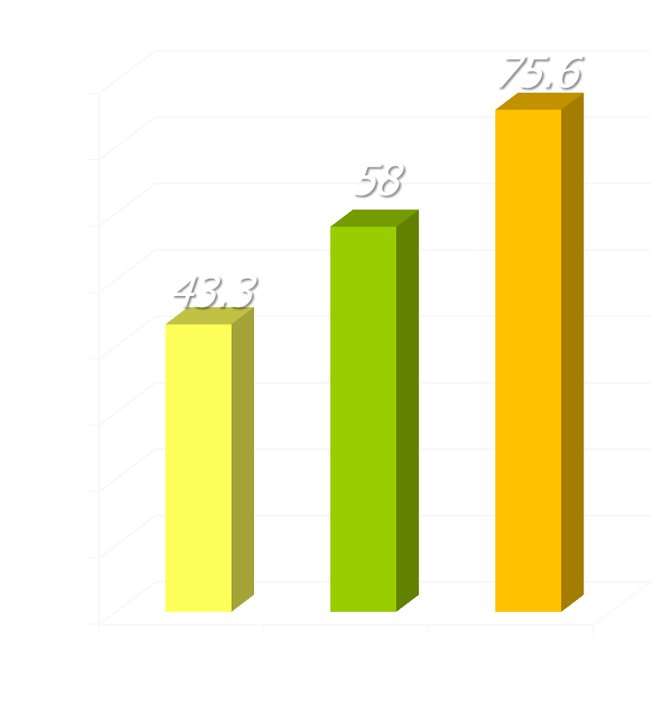
differences in recovery rates
research in UK NHS adult primary care counseling & psychological therapy services
recovery rates
study of 119 therapists treating 10,786 patients
recovery used the standard Jacobson & Truax criteria: reliable change to below the clinical cut-off
three groups of therapists found, comprising 19 poor (16%), 79 average (66%), and 21 excellent (18%)
Saxon, D. & M. Barkham (2012). "Patterns of therapist variability: Therapist effects & the contribution of patient severity and risk." J Consult Clin Psychol 80(4): 535-546.

