Slide 1
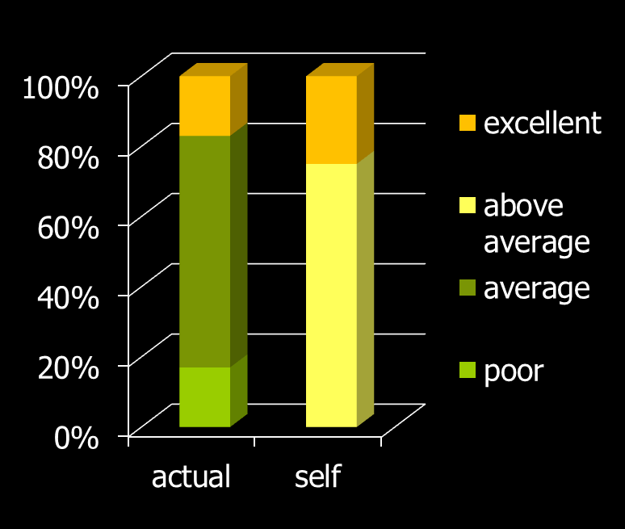
self-assessment isn’t accurate
multidisciplinary sample of mental health professionals
compare their own overall clinical skills & performance to others in their profession
25% assessed themselves to be in the top 10% of skills & performance & none viewed themselves as below average
assessment
Walfish, S., B. McAlister, et al. (2012). "An investigation of self-assessment
bias in mental health providers." Psychol Rep 110(2): 639-644.
Davis, D., et al. (2006). "Accuracy of physician self-assessment compared with observed measures of competence: A systematic review." JAMA 296: 1094-1102

