Slide 1
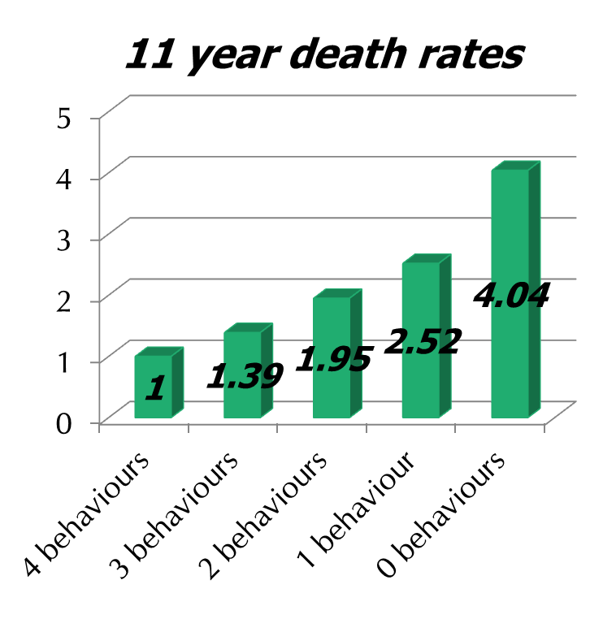
do you want to be 14 yrs younger?
20,224 UK adults
aged 45 to 79
no initial cancer/CHD
health behaviours rated
    not smoking
    physically active
    at least 5 fruit & veg daily
    1-14 alcohol units weekly
Khaw K-T, et al. “Combined impact of health behaviours …” PLoS Med 2008;5(1):e12

