Slide 1
recent research on non-drug treatments for bipolar disorder
james hawkins, goodmedicine.org.uk
lothian bipolar self-help group, 7th april ‘16

Slide 2
personal background
trained & worked as a medical doctor – still registered with the GMC, but no longer with an active ‘licence to practice’ (I don’t write prescriptions, but I pay a lot less for professional insurance as a psychotherapist).
trained and accredited as a CBT therapist and also have trainings in emotion-focused therapy, inter-personal psychotherapy & psychosexual medicine.
have lectured on & taught psychotherapy nationally & internationally; taught seminars for GP’s on depression treatment; served on SIGN guideline anxiety disorders working party; and chaired the clinical advisory group for the Scottish Action on Depression charity
produce a bimonthly evidence-based newsletter that goes out to over 2,500 therapists around the world – and I blog on health-related topics including this talk!
www.stressedtozest.com for blog posts on this talk & for newsletter
Notes:
Carlson et al - 3573
29 studies involving 1206 patients reviewed. results were encouraging and tended to increase between end of treatment and follow-up assessments about 3 months later. more sessions (about 12 sessions over 12 weeks) and the use of tapes are beneficial. individual a bit better than group if similar time. psychological and physical symptoms respond approximately equally well.

Slide 3

areas we’ll touch on
importance of adequate tracking
the value of psychotherapy
importance of sleep interventions
exercise & light
good diet is central
dietary supplements & other augmentation substances
overall lifestyle, mood & mortality

Slide 4
importance of adequate tracking
assessment measures for bipolar disorder are OK but a bit of a mishmash!
Miller, C., J. , et al. (2009). "Assessment tools for adult bipolar disorder." Clinical Psychology: Science and Practice 16(2): 188-201.
so far many mobile apps tend not to be well based on current guidelines
Nicholas, J., et al. (2015). "Mobile apps for bipolar disorder: a systematic review of features and content quality." J Med Internet Res 17(8): e198.
self rated life-chart methods look pretty helpful
Born, C., et al. (2014). "Saving time & money: a validation of the self ratings on the prospective NIMH life-chart method (NIMH-LCM)." BMC Psych 14(1): 130.
there are a variety of free paper & digital tracking tools available online
bipolar scotland monitoring booklet, beam mood chart, dbsa wellness tracker

Slide 5
the value of psychotherapy
there is evidence that psychological interventions are effective for people with bipolar disorder … further research should identify the most effective (and cost-effective) interventions for each phase of this disorder.
Oud, M., et al. (2016). "Psychological interventions for adults with bipolar disorder: systematic review and meta-analysis.” Br J Psychiatry 208(3): 213-222.
when compared with treatment as usual, collaborative care substantially reduced the time participants with bipolar disorder experienced depressive symptoms. Also, depressive symptom severity decreased significantly.
van der Voort, T. Y. G., et al. (2015). "Collaborative care for patients with bipolar disorder: randomised controlled trial." Br J Psychiatry 206(5): 393-400
the evidence demonstrates that bipolar disorder-specific psychotherapies, when added to medication … consistently show advantages over medication alone on measures of symptom burden and risk of relapse.
Swartz, H. A. and J. Swanson (2014). "Psychotherapy for bipolar disorder in adults: A review of the evidence." Focus 12: 251-266
therapeutic alliance (TA) has a causal effect on symptomatic outcome of a psychological treatment, and that poor TA is actively detrimental.
Goldsmith, L. P., et al. (2015). "Psychological treatments for early psychosis can be beneficial or harmful, depending on the therapeutic alliance: an instrumental variable analysis." Psychological Medicine 45(11): 2365-2373.

Slide 6
the value of psychotherapy
Parikh, S. V., et al. (2015). "Combined treatment: impact of optimal psycho-therapy and medication in bipolar disorder." Bipolar Disorders 17(1): 86-96
Bond, K. and I. M. Anderson (2015). "Psychoeducation for relapse prevention in bipolar disorder: a systematic review of efficacy in randomized controlled trials." Bipolar Disorders 17(4): 349-362.
van der Voort, T. Y., et al. (2015). "Functional v’s syndromal recovery in patients with major depressive disorder & bipolar disorder." J Clin Psych 76(6): e809-814
Jones, S. H., et al. (2015). "Recovery-focused CBT for recent-onset bipolar disorder: randomised controlled pilot trial." Br J Psychiatry 206(1): 58-66
Lauder, S., et al. (2015). "A randomized head to head trial of MoodSwings.net.au: internet based self-help program for bipolar disorder." J Affect Disord 171: 13-21
Goes, F. S. (2015). "The importance of anxiety states in bipolar disorder." Curr Psychiatry Rep 17(2): 3
Stratford, H. J., et al. (2015). "Psychological therapy for anxiety in bipolar spectrum disorders: a systematic review." Clin Psychol Rev 35: 19-34
Di Simplicio, M., et al. (2015). "Mental imagery and mood instability: a case series of imagery-focused CBT for bipolar disorder." Bipolar Disord S1(17): 42-43
Janiri, D., et al. (2015). "Childhood traumatic experiences of patients with bipolar disorder type I and type II." J Affect Disord 175: 92-97

Slide 7
development & maintenance of distressed states
*
after a series of distressed episodes e.g. in recurrent depression, external triggers become less important
genetic tendencies
behaviours
body state
life
events
change
loss, illness
parents
and family
coping
style
recent
triggers*
distressed
state
future
hopes
conflict
trauma, threat
life
situation
experiences growing up
relationships
beliefs
vulnerability factors
triggering factors
maintaining factors

Slide 8
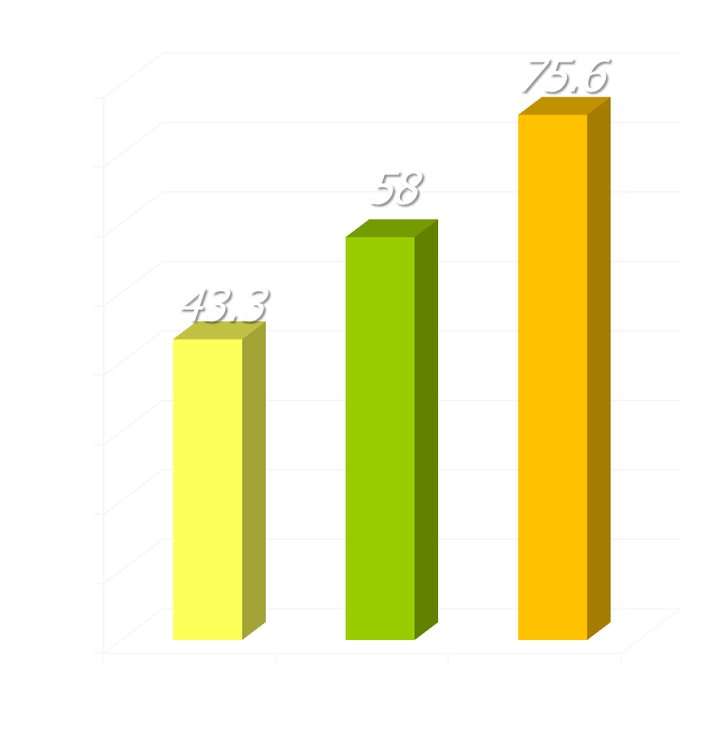
differences in recovery rates
research in UK NHS adult primary care counseling & psychological therapy services
recovery rates
study of 119 therapists treating 10,786 patients
recovery used the standard Jacobson & Truax criteria: reliable change to below the clinical cut-off
three groups of therapists found, comprising 19 poor (16%), 79 average (66%), and 21 excellent (18%)
Saxon, D. & M. Barkham (2012). "Patterns of therapist variability: Therapist effects & the contribution of patient severity and risk." J Consult Clin Psychol 80(4): 535-546.

Slide 9
areas we’ll touch on
importance of adequate tracking
the value of psychotherapy
importance of sleep interventions
exercise & light
good diet is central
dietary supplements & other augmentation substances
overall lifestyle, mood & mortality

Slide 10
importance of sleep interventions
circadian & seasonal characteristics related to BD are also associated
with a past history of hypomanic symptoms in non-clinical samples …
Bae, M., et al. (2014). "Lifetime experiences of hypomanic symptoms are associated with delayed and irregular sleep-wake cycle and seasonality in non-clinical adult samples." Compr Psychiatry 55(5): 1111-1115.
adults with interepisode bipolar disorder appear worse than normal controls in most variables & comparable to adults with primary insomnia
in certain aspects. Sleep onset latency, wake after sleep onset, and variability of sleep-wake variables were most consistently impaired.
Ng, T. H., et al. (2015). "Sleep-wake disturbance in interepisode bipolar disorder and high-risk individuals: a systematic review." Sleep Med Rev 20: 46-58.
Pittsburgh Sleep Quality Index (PSQI) global score … correlated signifi-cantly with residual mood symptoms & predicted earlier mood episode recurrence, even after covarying for residual mood symptoms.
Cretu, J. B., et al. (2016). "Sleep, residual mood symptoms, and time to relapse in recovered patients with bipolar disorder." J Affective Disorders 190: 162-166.
women reported poorer perceived sleep quality (PSQI) than men,
and poor sleep quality predicted worse mood outcome in BD.
Saunders, E. F., et al. (2015). "The effect of poor sleep quality on mood outcome differs between men and women in bipolar disorder." J Affect Disord 180: 90-96.

Slide 11
importance of sleep interventions
CBTI-BP was associated with reduced risk of mood episode relapse and improved sleep and functioning on certain outcomes in bipolar disorder.
Harvey, A. G., et al. (2015). "Treating insomnia improves mood state, sleep, and functioning in bipolar disorder: pilot RCT." J Consult Clin Psychol 83(3): 564-577.
management of the sleep disturbances experienced by bipolar patients, including insomnia, hypersomnia delayed sleep phase, and irregular sleep-wake schedule, may include medication approaches, psychological interventions, light therapies and sleep deprivation.
Harvey, A. G., et al. (2015). "Interventions for Sleep Disturbance in Bipolar Disorder." Sleep Med Clin 10(1): 101-105.
sleep restriction and stimulus control appear to be safe and efficacious procedures for treating insomnia in … bipolar disorder. Practitioners should encourage regularity in bedtimes and rise times as a first step in treatment.
Kaplan, K. A. and A. G. Harvey (2013). "Behavioral treatment of insomnia in bipolar disorder." Am J Psychiatry 170(7): 716-720.
54.1% were found to be in the high-risk category for OSA. Participants at high risk for OSA scored significantly higher on measures of both depression and mania, even when sleep items were not counted … and note the strong correlation with inability to grip one’s fingers round one’s neck.
Soreca, I., et al. (2012). "Sleep apnea risk and clinical correlates in patients with bipolar disorder." Bipolar Disord 14(6): 672-676 … and Edmonds, P. (2015).

Slide 12
cbti-bp v’s psychoeducation
relapse rates over 6 months follow-up
58 participants with inter-episode BP 1 and insomnia randomized to CBTI-BP or active psychoeducation
exclusion criteria included substance abuse, sleep apnea, current ptsd, etc
all received eight 1:1 sessions – CBTI-BP involved education & four modules a.) behaviours b.) cognitions c.) daytime functioning, and d.) relapse prevention
Harvey, A. G., et al. (2015). "Treating insomnia improves mood state, sleep, and functioning in bipolar disorder: a pilot RCT." J Consult Clin Psychol 83(3): 564-577.

Slide 13
sleep, light & exercise
ongoing studies on effectiveness of sleep deprivation plus light for bipolar depression – here extended to assessing brain pathways effected.
Vai, B., et al. (2015). "Successful antidepressant chronotherapeutics enhance fronto-limbic neural responses … in bipolar depression." Psych Res 233: 243-253.
bright light therapy is a well-established treatment for seasonal depression. In the last two decades, the interest in BLT has expanded to involve other nonseasonal types of depression … BLT appears to be efficacious, particu-larly when administered for 2–5 weeks’ duration and as monotherapy.
Al-Karawi, D. and L. Jubair (2016). "Bright light therapy for nonseasonal depression: Meta-analysis of clinical trials." J Affective Disorders 198: 64-71.
virtual darkness therapy (blue light-blocking treatment by means of orange-tinted glasses) is a promising new treatment option for mania.
Henriksen, T. E. G., et al. (2014). "Blocking blue light during mania – markedly increased regularity of sleep and rapid improvement of symptoms: a case report." Bipolar Disorders 16(8): 894-898.
generally, exercise was associated with improved health measures including depressive symptoms, functioning and quality of life. Evidence was insufficient to establish a cause-effect relationship …
Melo, M. C. A., et al. (2016). "Exercise in bipolar patients: A systematic review." Journal of Affective Disorders 198: 32-38.

Slide 14
areas we’ll touch on
importance of adequate tracking
the value of psychotherapy
importance of sleep interventions
exercise & light
good diet is central
dietary supplements & other augmentation substances
overall lifestyle, mood & mortality

Slide 15
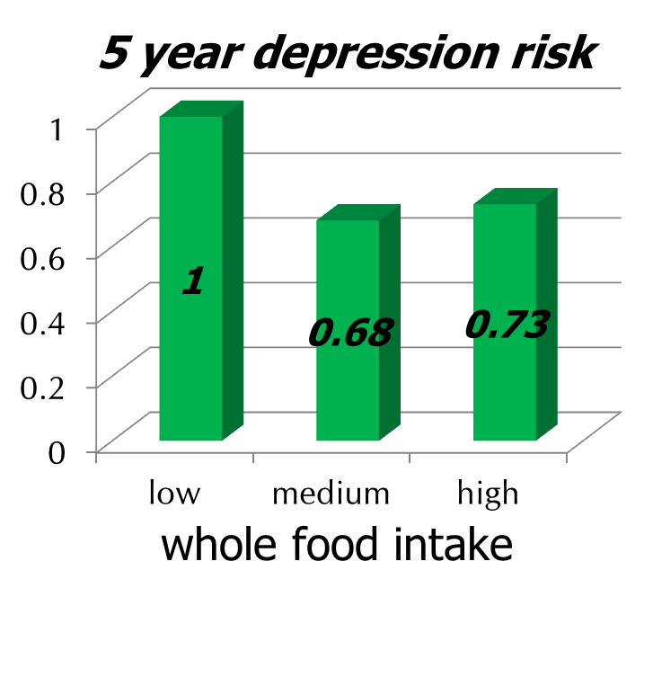
whole food diet & depression risk
3,059 adults who were not initially depressed
starting age 35 to 55
whole food diet tertiles: intake of vegetables, fruit and fish measured
presence of depression assessed 5 years later
multiple other potential confounding factors allowed for
Akbaraly, T. et al. (2009). "Dietary pattern and depressive symptoms in middle age.“ Br J Psych 195(5): 408-413.

Slide 16
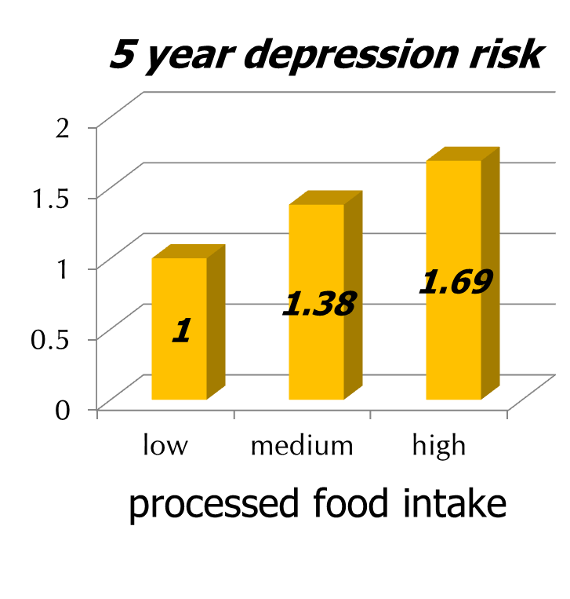
processed diet & depression risk
even more striking: the link between processed food intake & the risk of subsequent depression
processed diet tertiles: sweetened desserts, fried food, processed meat, refined grains & high fat dairy products

Slide 17
… & research continues to emerge
Lopresti, A. L. & F. N. Jacka (2015). "Diet and bipolar disorder: a review of its relationship and potential therapeutic mechanisms of action." J Altern Complement Med 21(12): 733-739.
Hajek, T., et al. (2015). "Type 2 diabetes mellitus: a potentially modifiable risk factor for neurochemical brain changes in bipolar disorders." Biol Psychiatry 77(3): 295-303.
Sylvia, L. G., et al. (2013). "Nutrient-based therapies for bipolar disorder: systematic review." Psychother Psychosom 82: 10-19.
Sánchez-Villegas, A., et al. (2012). "Fast-food … consumption & risk of depression." Public Health Nutrition 15: 424-432.
Jacka, F. N., et al. (2011). "The association between habitual diet quality and the common mental disorders in community-dwelling adults." Psychosomatic Medicine 73(6): 483-490.
Jacka, F. N., et al. (2011). "A prospective study of diet quality and mental health in adolescents." PLoS One 6(9): e24805

Slide 18
dietary supplements & other augmentation substances
meta-analytic findings provide strong evidence that bipolar depressive symptoms may be improved by adjunctive use of omega-3
Sarris, J., et al. (2012). "Omega-3 for bipolar disorder: meta-analyses of use in mania and bipolar depression." J Clin Psychiatry 73(1): 81-86.
NAC appears a safe and effective augmentation strategy for depressive symptoms in bipolar disorder.
Berk, M., et al. (2008). "N-acetyl cysteine for depressive symptoms in bipolar disorder - a double-blind RCT." Biol Psychiatry 64(6): 468-475.
current evidence for aspirin or celecoxib is insufficient though further investigation of the potential of celecoxib in early illness onset is warranted … the strongest evidence emerged for NAC in depression and future studies must address the role of illness duration and patients baseline medications.
Ayorech, Z., et al. (2015). "Taking the fuel out of the fire: evidence for the use of anti-inflammatory agents in the treatment of bipolar disorders." J Affect Disord 174: 467-478.
the most commonly taken supplements for both groups were fish oil, B vitamins, melatonin, and multivitamins.
Bauer, M., et al. (2015). "Common use of dietary supplements for bipolar disorder: a naturalistic, self-reported study." Int J Bipolar Disord 3(1): 29

Slide 19
areas we’ll touch on
importance of adequate tracking
the value of psychotherapy
importance of sleep interventions
exercise & light
good diet is central
dietary supplements & other augmentation substances
overall lifestyle, mood & mortality

Slide 20
overall lifestyle … !
Background Research evidence on the effects of integrated multifaceted lifestyle interventions for depression is scanty. The aim of the present study is to report on the development, acceptability and efficacy of a standardized healthy lifestyle intervention, including exercise, eating habits, sleep hygiene and smoking cessation in preventing relapses. Methods 160 outpatients with recurrent unipolar depression or bipolar disorder were recruited after achieving full remission or recovery from the most recent depressive episode. Patients were randomized to 3-months of usual care or to an intervention aimed at promoting a healthy lifestyle (HLI), as an augmentation of pharmacological maintenance treatment … At the end of the intervention, follow-up visits were scheduled at 3, 6, 9 and 12 months. Results During the intervention phase, 1 relapse occurred in the HLI group and 4 in the control group. Over the 12 months of follow-up, relapses were 5 in the HLI group and 16 in control group. Using an intent-to-treat approach, the overall percentage of relapses was 6/81 (7.4%) in the HLI group vs. 20/79 (25.3%) in the control group … The majority of patients assigned to HLI adhered to the program, and were highly motivated throughout the intervention … Conclusions The HLI program proved to be efficacious in preventing relapses. Given the absence of contraindications & its cost-effectiveness in routine practice, the use of HLI should be encouraged to promote the well-being of patients with recurrent depression.
Goracci, A., et al. (2016). "Development, acceptability and efficacy of a standardized healthy lifestyle intervention in recurrent depression." J Affect Disorders 196: 20-31.

Slide 21
areas we’ve touched on
importance of adequate tracking
the value of psychotherapy
importance of sleep interventions
exercise & light
good diet is central
dietary supplements & other augmentation substances
overall lifestyle, mood & mortality

