Slide 1
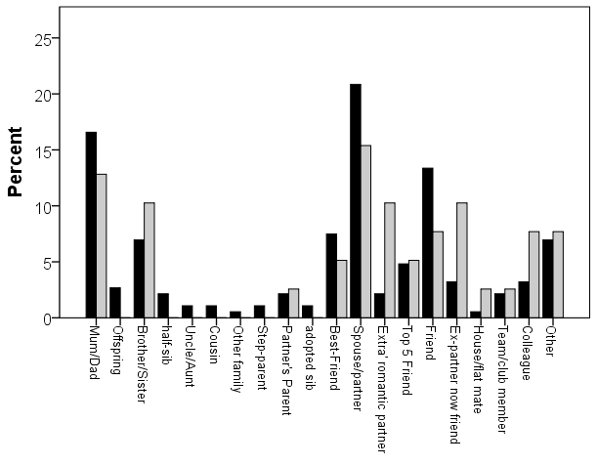
which relationships involved

Slide 2
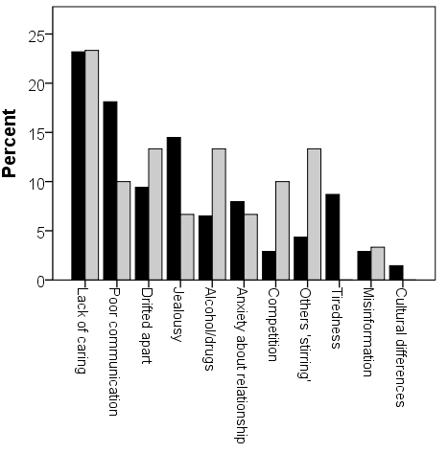
cause of ‘severe falling out’
women: black columns
men: grey
columns
cause was selected from a list of 14 possible choices
Dunbar & Machin, 2014

