Slide 1
how can we help our clients more effectively?
James Hawkins
Edinburgh, Scotland

Slide 2

key points of this talk
psychotherapy’s current state: some reasons to be pleased
psychotherapy’s current state: some reasons to be worried
the major benefits we can achieve through balancing evidence-based practice with practice-based evidence
new insights from cross disciplinary research on how humans develop excellence

Slide 3
back story: clearings in the clouds
cairngorm walk in june – the sneck, a high level link to ben avon
april 2011, lars-goran ost on lack of progress over four decades of cbt anxiety research
july 2011, michael lambert on ‘pseudoshrinks & supershrinks’
may 2013, anders ericsson on the development of excellence
great if this talk could be a ‘clearing in the clouds’ for you

Slide 4
reasons to be pleased
100’s of psychotherapy meta-analyses show effect sizes of approximately 0.6 (0.4 to 0.8)
in the social sciences, this is a ‘medium’ to ‘strong’ effect size (for Cohen’s d)
it makes psychotherapy as or more potent than many well established EBM procedures including (for example) almost all intervent-ions in asthma, geriatrics, and cardiology
Lambert, M. J. (2013). “The efficacy and effectiveness of psychotherapy”
in M. J. Lambert (ed) “Handbook of psychotherapy and behavior change (6th ed)”

Slide 5
reasons to be pleased
reductions in relapse rates compared to medication or no treatment – so for depression a meta-analysis by De Maat et al (2006) reported a relapse rate of 27% for psychotherapy but a rate of 57% for pharmacotherapy (if medication was discontinued)
there is also a growing research literature (Smith & Williams, 2013) highlighting reductions in medical & psychological treatment costs and reductions in time off work achievable with psychological interventions
De Maat, S., et al. (2006). "Relative efficacy of psychotherapy and pharmacotherapy in the treatment of depression: A meta-analysis." Psychotherapy Research 16(5): 566-578
Smith, T. W. & P. Williams (2013). “Behavioral medicine and clinical health psychology.” in M. J. Lambert (ed) “Handbook of psychotherapy and behavior change (6th ed)”

Slide 6
reasons to be pleased disappointed
100’s of psychotherapy meta-analyses show effect sizes of approximately 0.6 (0.4 to 0.8)
but since Smith, Glass & Miller’s estimate of an 0.85 effect size from a meta-analysis of 475 studies in 1980, there has been no general effectiveness increase over the next 33 years
in fact improved statistical methods suggest we have been over-estimating effectiveness
Lambert, M. J. (2013). “The efficacy and effectiveness of psychotherapy”
in M. J. Lambert (ed) “Handbook of psychotherapy and behavior change (6th ed)”

Slide 7

concerns about how well we help those struggling with depression
dodo bird: no large differences in efficacy between seven different approaches (Cuijpers et al, 2008)
research quality for third wave therapies such as ACT, DBT, etc somewhat poor (Ost, 2008)
publication bias seems to have considerably over-estimated effect sizes (Cuijpers et al, 2010)
Cuijpers, P., et al. (2008). "Psychotherapy for depression in adults: A meta-analysis of comparative outcome studies." J Consult Clin Psychol 76(6): 909-922.
Ost, L.-G. (2008). "Efficacy of the third wave of behavioral therapies: A systematic review and meta-analysis." Behaviour Research and Therapy 46(3): 296-321. Cuijpers, P., et al. (2010). "Efficacy of CBT & other psychological treatments for adult depression: Meta-analytic study of publication bias." Br J Psychiatry 196: 173-178.

Slide 8
... & those struggling with anxiety
“Psychological therapies, in general, have been found to be highly effective for anxiety-based problems. The family of cognitive and behavior therapies have been studied most often and extensively … “ (Lambert, 2013)
“Cognitive-behavior therapies (CBT) have been evaluated in randomized controlled studies (RCT) and anxiety disorders since 1966 … (No meta-analysis) … has looked at whether modern CBT studies lead to better treat-ment effects than were obtained 10-40 years ago. The aim of this paper is to present a meta-analysis focusing on the mean extent of change achieved by the CBT treatments across decades (from the 1970s onwards) … The results showed that in most instances there was no significant change in ES (effect size) across time … If the single studies that gave the highest ES each decade were compared, all anxiety disorders besides panic disorder and obsessive-compulsive disorder showed a positive development.” (Ost, 2008)
Lambert, M. J. (2013). “The efficacy and effectiveness of psychotherapy”
in M. J. Lambert (ed) “Handbook of psychotherapy and behavior change (6th ed)”
Ost, L. G. (2008). "Cognitive behavior therapy for anxiety disorders: 40 years of progress." Nord J Psychiatry 62 Suppl 47: 5-10.

Slide 9
back story: clearings in the clouds
april 2011, lars-goran ost on lack of progress over four decades of cbt anxiety research
july 2011, michael lambert on ‘pseudoshrinks & supershrinks’
may 2013, anders ericsson on the development of excellence
great if this talk could be a ‘clearing in the clouds’ for you

Slide 10

a focus only on therapy differences misses other crucial sources of help
Mulla Nasrudin
and the lost keys

Slide 11
increasingly research shows major differences between therapists
Brown, G. S. and E. R. Jones (2005). "Implementation of a feedback system in a managed care environment: What are patients teaching us?" Journal of Clinical Psychology 61(2): 187-198.
Okiishi, J. C., M. J. Lambert, et al. (2006). "An analysis of therapist treatment effects: Toward providing feedback to individual therapists on their clients' psychotherapy outcome." Journal of Clinical Psychology 62(9): 1157-1172
Lutz, W., S. C. Leon, et al. (2007). "Therapist effects in outpatient psychotherapy: A three-level growth curve approach." Journal of Counseling Psychology 54(1): 32-39.
Anderson, T., B. M. Ogles, et al. (2009). "Therapist effects: Facilitative interpersonal skills as a predictor of therapist success." Journal of Clinical Psychology 65: 755-768.
Kraus, D. R., L. Castonguay, et al. (2011). "Therapist effectiveness: Implications for accountability and patient care." Psychotherapy Research 21(3): 267-276.
Saxon, D. and M. Barkham (2012). "Patterns of therapist variability: Therapist effects & the contribution of patient severity and risk." J Consult Clin Psychol 80(4): 535-546.
Baldwin, S. A. & Imel, Z. E. (2013). “Therapist effects: Findings and methods” in M. J. Lambert (ed) “Handbook of psychotherapy and behavior change (6th ed)”

Slide 12
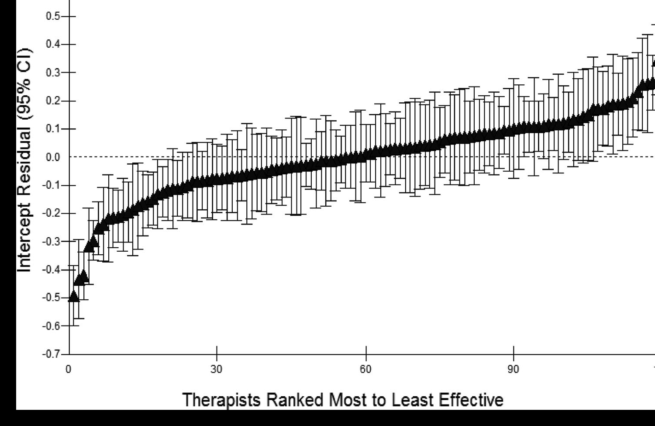
therapist effects
Saxon, D. & M. Barkham (2012). "Patterns of therapist variability: Therapist effects & the contribution of patient severity and risk." J Consult Clin Psychol 80(4): 535-546.

Slide 13
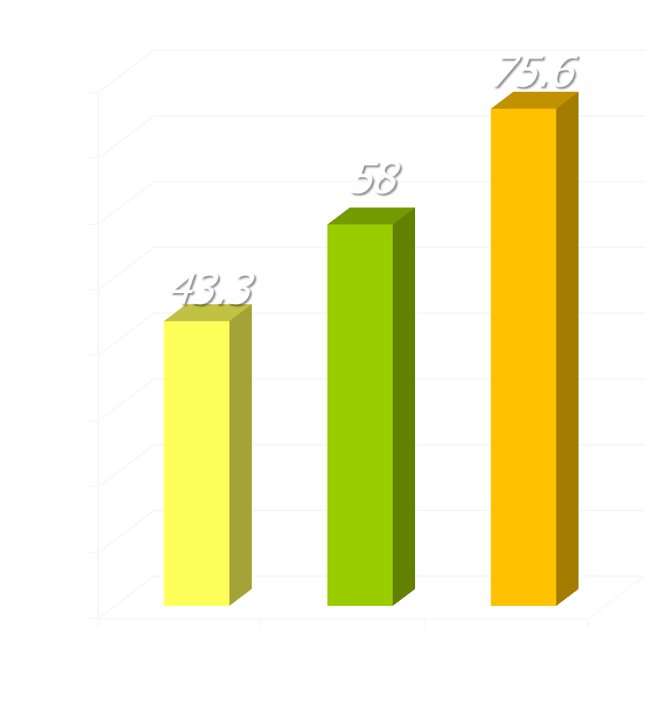
differences in recovery rates
research in UK NHS adult primary care counseling & psychological therapy services
recovery rates
study of 119 therapists treating 10,786 patients
recovery used the standard Jacobson & Truax criteria: reliable change to below the clinical cut-off
three groups of therapists found, comprising 19 poor (16%), 79 average (66%), and 21 excellent (18%)
Saxon, D. & M. Barkham (2012). "Patterns of therapist variability: Therapist effects & the contribution of patient severity and risk." J Consult Clin Psychol 80(4): 535-546.

Slide 14

why therapist effects differences?
research suggests that differences in therapist effectiveness are NOT due to:
type of therapy being used
therapist qualifications/training
duration of therapist experience
therapist age
therapist gender
Baldwin, S. A. and Z. E. Imel (2013). “Therapist effects: findings and methods”
in M. J. Lambert (ed) “Handbook of psychotherapy and behavior change (6th ed)”

Slide 15
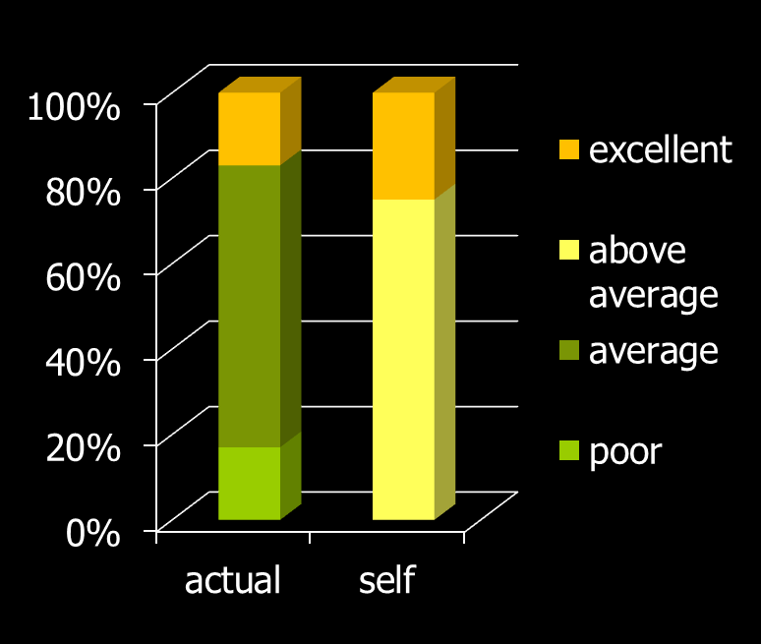
self-assessment isn’t accurate
multidisciplinary sample of mental health professionals
compare their own overall clinical skills & performance to others in their profession
25% assessed themselves to be in the top 10% of skills & performance & none viewed themselves as below average
assessment
Walfish, S., B. McAlister, et al. (2012). "An investigation of self-assessment
bias in mental health providers." Psychol Rep 110(2): 639-644.
Davis, D., et al. (2006). "Accuracy of physician self-assessment compared with observed measures of competence: A systematic review." JAMA 296: 1094-1102

Slide 16
therapist effects: tentative findings
the differences in outcome between better & worse therapists stand out most with more complex, challenging patients (Saxon & Barkham, 2012).
individual therapists tend to be “better” or “worse” with specific kinds of patient problem, rather than “better/worse” across the board (Kraus et al, 2011).
it seems that “facilitative interpersonal skills” demon-strated specifically in difficult interpersonal situations (rather than just more generally) are of particular importance (Anderson et al, 2009)
use of regular sessional outcome/alliance monitoring may be especially helpful for initially less effective therapists (Anker et al, 2009)

Slide 17
key points of this talk
psychotherapy’s current state: some reasons to be pleased
psychotherapy’s current state: some reasons to be worried
the major benefits we can achieve through balancing evidence-based practice with practice-based evidence
new insights from cross disciplinary research on how humans develop excellence

Slide 18
practice-based evidence
“At its heart, practice-based evidence is premised on the adoption and ownership of a bona fide measurement system and its implementation as standard procedure within routine practice.”
celesthealth system for mental health & college counseling settings (chs-mh) www.celesthealth.com
clinical outcomes in routine evaluation (core) www.coreims.co.uk
outcome questionnaire-45 (oq45) & linked measures www.oqmeasures.com
partners for change outcome management system (pcoms) http://scottdmiller.com & https://heartandsoulofchange.com
treatment outcome package (top) www.outcomereferrals.com
Castonguay, L., M. Barkham, W. Lutz, et al. (2013). “Practice-orientated research.” in M. J. Lambert (ed) “Handbook of psychotherapy and behavior change (6th ed)”

Slide 19
helping improve outcomes … especially when non-response risk
“ … repeated assessment and immediate feed-back of a patient’s mental health functioning during the course of therapy can alert therapists to patient non-response or negative response, support decisions on treatment planning and strategies (e.g. when and how to repair thera-peutic alliance ruptures) and help determine when treatment has been sufficient.”
Castonguay, L., M. Barkham, W. Lutz, et al. (2013). “Practice-orientated research.” in M. J. Lambert (ed) “Handbook of psychotherapy and behavior change (6th ed)”

Slide 20
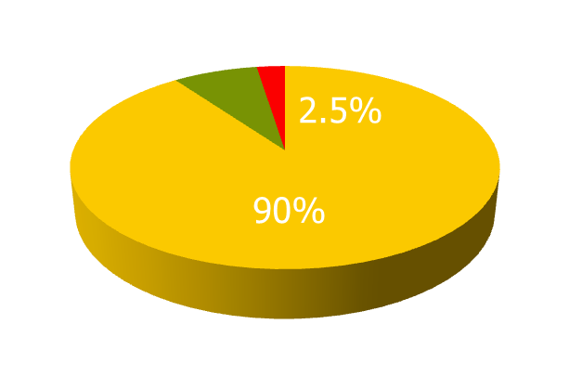
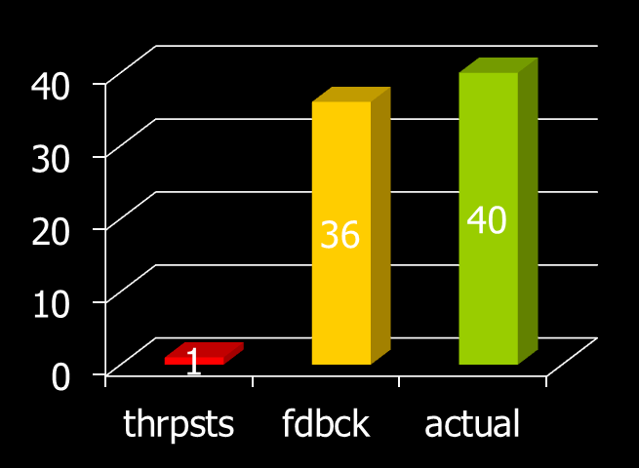
bad at identifying deterioration
550 clients & 48 therapists (22 licensed, 26 trainees)
told that 8% of clients would probably deteriorate & they were asked to identify them
40/550 (7.3%) of clients actually deteriorated (OQ-45)
actuarial feedback identified 36/40 – a 90% detection rate
therapists identified 3, only 1 of whom actually deteriorated – a 2.5% detection rate
it was a trainee who was the only one who was accurate
Hannan, C., M. J. Lambert, et al. (2005). "A lab test and algorithms for identifying clients at risk for treatment failure." Journal of Clinical Psychology 61(2): 155-163.

Slide 21
using regular sessional feedback helps therapists improve outcomes
M. Barkham, G. E. Hardy & J. Mellor-Clark (ed’s) (2010) “Developing and delivering practice-based evidence.” Chichester: John Wiley & Sons.
Newnham, E. A. and A. C. Page (2010). "Bridging the gap between best evidence and best practice in mental health." Clin Psychol Rev 30(1): 127-142.
Shimokawa, K., M. J. Lambert, et al. (2010). "Enhancing treatment outcome of patients at risk of treatment failure: Meta-analytic and mega-analytic review of a psychotherapy quality assurance system." J Consult Clin Psychol 78(3): 298-311.
Lambert, M. J. (2010) "Prevention of treatment failure: the use of measuring, monitoring, and feedback in clinical practice". Washington: Am Psych Association
Lutz, W., J. R. Bohnke, et al. (2011). "Lending an ear to feedback systems: Evaluation of recovery and non-response in psychotherapy in a German outpatient setting." Community Ment Health J 47(3): 311-317.
Whipple, J. L. and M. J. Lambert (2011). "Outcome measures for practice." Annual review of clinical psychology 7: 87-111.
Carlier, I. V., D. Meuldijk, et al. (2012). "Routine outcome monitoring & feedback on physical or mental health status: Evidence and theory." J Eval Clin Pract 18: 104-110.

Slide 22
to get best results from feedback
best results typically depend on the therapists involved being committed to using feedback
regular sessional assessment of outcome progress & therapeutic alliance given to both therapist & client for possible discussion
current evidence suggests this halves client deterioration rates
there are encouraging increases in treatment gains as well - e.g. using pcoms, reliable improve-ment rates increase by 3.5 x
Castonguay, L., M. Barkham, W. Lutz, et al. (2013). “Practice-orientated research.” in M. J. Lambert (ed) “Handbook of psychotherapy and behavior change (6th ed)”

Slide 23
key points of this talk
psychotherapy’s current state: some reasons to be pleased
psychotherapy’s current state: some reasons to be worried
the major benefits we can achieve through balancing evidence-based practice with practice-based evidence
new insights from cross disciplinary research on how humans develop excellence

Slide 24
back story: clearings in the clouds
april 2011, lars-goran ost on lack of progress over four decades of cbt anxiety research
july 2011, michael lambert on ‘pseudoshrinks & supershrinks’
may 2013, anders ericsson on the development of excellence
great if this talk could be a ‘clearing in the clouds’ for you

Slide 25
ericsson & achieving excellence
Ericsson, K. A. (2013) “The science of excellence meets psychotherapy.” lecture at “Achieving clinical excellence .” conference. May 17th, Amsterdam.
Ericsson, K. A., K. Nandagopal, et al. (2009). "Toward a science of exceptional achievement: Attaining superior performance through deliberate practice." Ann N Y Acad Sci 1172: 199-217.
Ericsson, K. A. (2008). "Deliberate practice and acquisition of expert performance: A general overview." Acad Emerg Med 15(11): 988-994.
Ericsson, K. A., J. t. Whyte, et al. (2007). "Expert performance in nursing: Reviewing research on expertise in nursing within the framework of the expert-performance approach.“ ANS Adv Nurs Sci 30(1): E58-71.
Ericsson, K. A., M. J. Prietula, et al. (2007). "The making of an expert." Harv Bus Rev 85(7-8): 114-121, 193.
Ericsson, K. A. (2007). "An expert-performance perspective of research on medical expertise: The study of clinical performance." Med Educ 41(12): 1124-1130.
Ericsson, K. A. (2004)."Deliberate practice & the acquisition & maintenance of expert performance in medicine & related domains." Acad Med 79(10 Suppl): S70-81.
Ericsson, K. A., Krampe, R. T. & Tesch-Romer, C. (1993). “The role of deliberate practice in the acquisition of expert performance." Psychol Review 100(3): 363-406.
Notes:
Benor in his 1990 survey states that a he identified 131 controlled trials of spiritual healing in English of which 56 showed statistically significant results at p<.01 or better and another 10 at p<.02-.05. The studies involved healing effects on enzymes, cells, yeasts, bacteria, plants, animals and man.
The study published in Holistic Medicine describes the fascinating work on anaesthetized mice which amongst other things showed a “linger effect”.

Slide 26
growing numbers of relevant books
K. A. Ericsson (ed.) (2009) “Development of professional expertise: Toward measurement of expert performance and design of optimal learning environ-ments.” Cambridge, England: Cambridge University Press.
K. A. Ericsson, et al. (ed) (2006). "The Cambridge handbook of expertise and expert performance.” Cambridge, England: Cambridge University Press.
K. A. Ericsson (ed.) (1996) “The road to excellence: The acquisition of expert performance in the arts and sciences, sports, and games.” New Jersey: Erlbaum
Lemov, D., Woolway, E. & Yezzi, K. (2012) “Practice perfect: 42 rules for getting better at getting better.” San Francisco: Jossey-Bass.
Ankerson, R. (2012) “The gold mine effect.” London: Icon Books.
Shenk, D. (2010) “The genius in all of us.” London: Icon Books.
Syed, M. (2010) “Bounce: The myth of talent and the power of practice.” London: Fourth Estate.
Coyle, D. (2009) “The talent code.” New York: Bantam.
Gladwell, M. (2008) “Outliers." Little, Brown and Company.
Colvin, G. (2008) “Talent is overrated: What really separates world-class performers from everybody else.” New York: Penguin.
Dweck, C. (2006) “Mindset: How you can fulfil your potential.” NY: Ballantine.
Notes:
Benor in his 1990 survey states that a he identified 131 controlled trials of spiritual healing in English of which 56 showed statistically significant results at p<.01 or better and another 10 at p<.02-.05. The studies involved healing effects on enzymes, cells, yeasts, bacteria, plants, animals and man.
The study published in Holistic Medicine describes the fascinating work on anaesthetized mice which amongst other things showed a “linger effect”.

Slide 27
true expertise & deliberate practice
“Traditionally, professional expertise has been judged by length of experience, reputation, and perceived mastery of knowledge and skill. Unfortunately, recent research demonstrates only a weak relationship between these indicators of expertise and actual, observed performance … Expert performance can, however, be traced to active engagement in deliberate practice (DP), where training (often designed and arranged by their teachers and coaches) is focused on improving particular tasks. DP also involves the provision of immediate feedback, time for problem-solving and evaluation, and opportunities for repeated performance to refine behavior.”
Ericsson, K. A. (2008). "Deliberate practice and acquisition of expert performance: A general overview." Acad Emerg Med 15(11): 988-994.

Slide 28
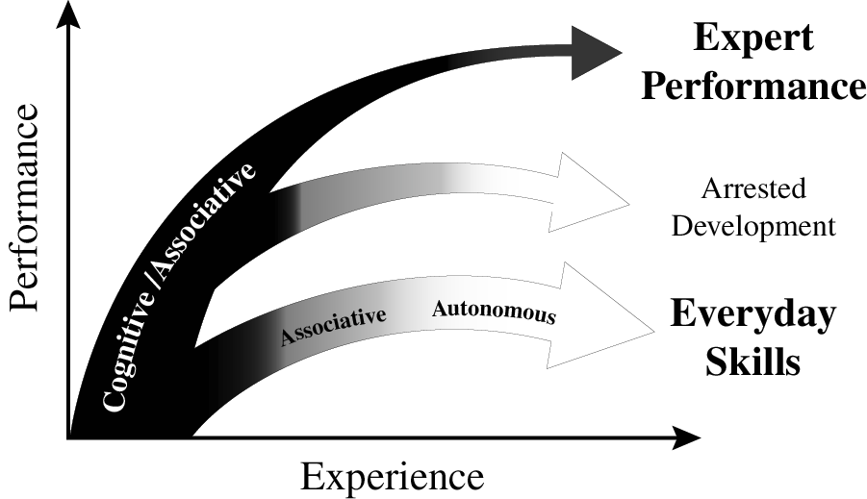
experience & variety of outcomes
Ericsson K. Anders. (2013). "The science of human excellence meets psychotherapy.” lecture at “Achieving clinical excellence conference.” May 17th, Amsterdam.

Slide 29
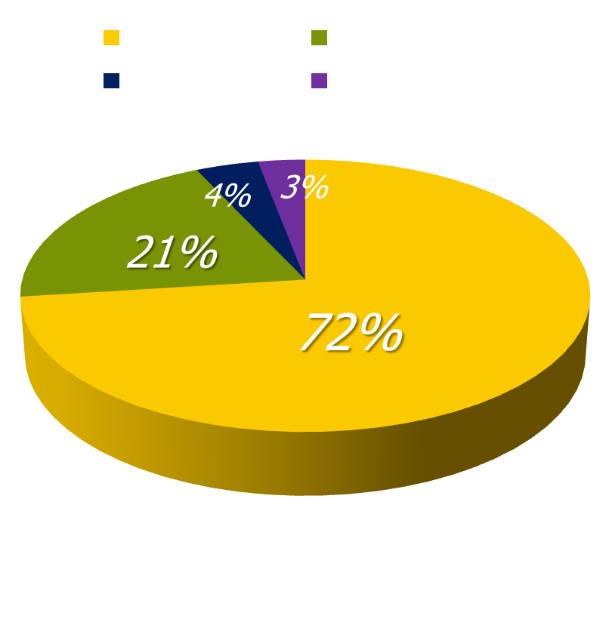
the effects of increasing experience
systematic review of 62 studies published between 1966 and 2004 looking at physician experience effects
73% found increasing experience associated with decreasing performance for some (21%) or all (52%) outcomes assessed
there seems to be an inverse relationship between years of experience and the quality of care that is provided
Choudhry, N. K., et al. (2005). "Systematic review: The relationship between clinical experience and quality of health care." Ann Intern Med 142(4): 260-273.

Slide 30
the effects of increasing experience
Researchers examined the association between experience and mortality rates for surgeons performing cardiac artery bypass grafting. After adjustment for both patient and doctor variables, they found that surgeons who had been in practice longer had higher operative mortality rates (P<0.001).
Hartz A. J., et al. (1999). “Prestige of training programs and experience of bypass surgeons as factors in adjusted patient mortality rates.” Med Care. 37:93-103.
Mortality rates were analyzed for 39,007 hospitalized patients with acute myo-cardial infarction managed by 4,546 cardiologists, internists & family practition-ers. After controlling for patient’s probability of death, hospital location & pract-ice environment, physician specialty, board certification & the volume of pati-ents seen, the researchers found a 0.5% increase in mortality for every year since the treating physician had graduated from medical school.
Norcini, J. J., et al. (2000). "Certification and specialization: Do they matter in the outcome of acute myocardial infarction?" Academic Medicine 75(12): 1193-1198.

Slide 31
maintaining expertise
"If I don't practice one day, I know it; two days, the critics know it; three days, the public knows it.“ Jascha Heifetz
Krampe, R. T. and K. A. Ericsson (1996). "Maintaining excellence: Deliberate practice and elite performance in young and older pianists." J Exp Psychol Gen 125(4): 331-359. Two studies investigated the role of deliberate practice in the maintenance of cognitive-motor skills in expert and accomplished ama-teur pianists. Older expert and amateur pianists showed the normal pattern of large age-related reductions in standard measures of general processing speed. Performance on music-related tasks showed similar age-graded dec-line for amateur pianists but not for expert pianists, whose average perform-ance level was only slightly below that of young expert pianists. The degree of maintenance of relevant pianistic skills for older expert pianists was pre-dicted by the amount of deliberate practice during later adulthood. The role of deliberate practice in the active maintenance of superior domain-specific performance in spite of general age-related decline is discussed.

Slide 32
experience & variety of outcomes
Ericsson K. Anders. (2013). "The science of human excellence meets psychotherapy.” lecture at “Achieving clinical excellence conference.” May 17th, Amsterdam.

Slide 33
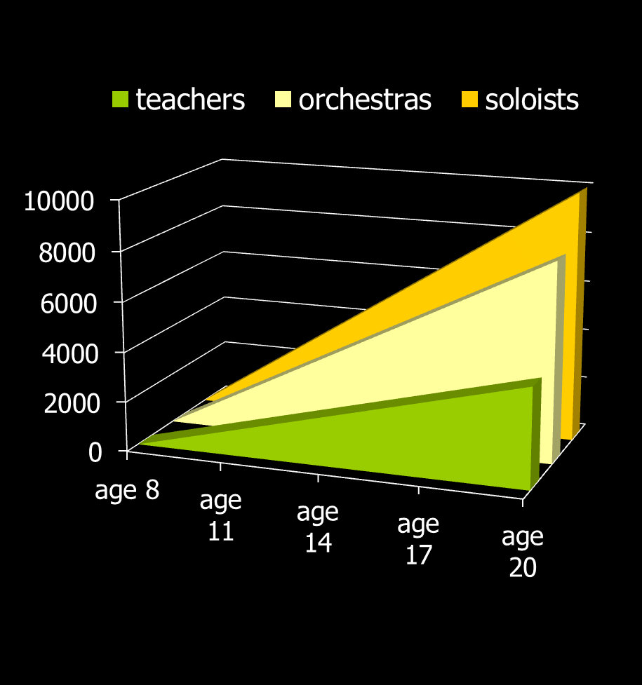
musicians & deliberate practice
classic early study on 20 yr old
violin students at the renowned
Music Academy of West Berlin
painstaking series of interviews
students sorted into 3 groups by professors’ assessments and success in open competitions
groups indistinguishable by average age of starting violin (age 8), average age at which decided to become musicians (just before age 15), number of teachers, etc. etc.
what stood out dramatically were the differences in hours spent practising – with no exceptions!
Ericsson, K. A., Krampe, R. T. & Tesch-Romer, C. (1993). “The role of deliberate practice in the acquisition of expert performance." Psychol Review 100(3): 363-406.

Slide 34
chess players & deliberate practice
it was time spent in “serious analysis of chess positions on one’s own” that was found to build expert performance (e.g. predicting key moves in games involving chess masters).
“active participation in chess tournaments” was unrelated to improvement, and “playing chess games outside chess tournaments” was a negative predictor of improvement.
the increased availability of chess computer programmes has been associated with a reduction in the time taken to become a grandmaster from about 10 years to 5 – 6 years.
there has also been the emergence of world class players from small countries (with little significant chess history) such as Norway (Magnus Carlsen).
Charness, N., et al. (1996). “The role of practice and coaching in entrepreneurial skill domains: An international comparison of life-span chess skill acquisition.” in K. A. Ericsson (ed.) “The road to excellence.” (51-80). Hillsdale, NJ: Lawrence Erlbaum.

Slide 35
chess players & deliberate practice
Charness, N., et al. (1996). “The role of practice and coaching in entrepreneurial skill domains: An international comparison of life-span chess skill acquisition.” in K. A. Ericsson (ed.) “The road to excellence.” (51-80). Hillsdale, NJ: Lawrence Erlbaum.

Slide 36
psychotherapy & deliberate practice
17 therapists & 1,632 clients were studied – therapists were classified into four quartiles depending on their effectiveness.
as expected – qualifications, profession, experience, age, and gender were found to be unrelated to effectiveness.
fascinatingly, when asked about their use of client feedback, more successful therapists were much more likely to report being “surprised” by it – possibly a measure both of how well they had “set up” the feedback & of their openness/receptivity
also significant was their answer to the question: “How many hours per week (on average) do you spend alone seriously engaging in activities related to improving your therapy skills in the current year?” – the quartiles answered on average 7.39 (1st quartile); 4.13 (2nd); 2.00 (3rd) & 0.50 hours (4th quartile).
Chow, D. L., Miller, S. D., Kane, B., Thornton, J. (n.d.) ”The study of supershrinks: Development & deliberate practices of highly effective psychotherapists.” (in prep’n).

Slide 37
psychotherapy & deliberate practice
“solitary activities” included ”reviewing therapy recordings alone, reviewing difficult/challenging cases alone, mentally running through & reflecting on past sessions in one’s mind, mentally running through & reflecting on what to do in future sessions, writing down reflections of past sessions, writing down plans for future sessions, viewing master therapist videos with the aim of developing specific thera-peutic skills as a therapist, reading case examples (e.g. narratives, transcripts, case studies), reading of journals pertaining to psychotherapy & counselling, reading/re-read-ing of core counselling & therapeutic skills in psychotherapy.”
Chow, D. L., Miller, S. D., Kane, B., Thornton, J. (n.d.) ”The study of supershrinks: Development & deliberate practices of highly effective psychotherapists.” (in prep’n).

Slide 38
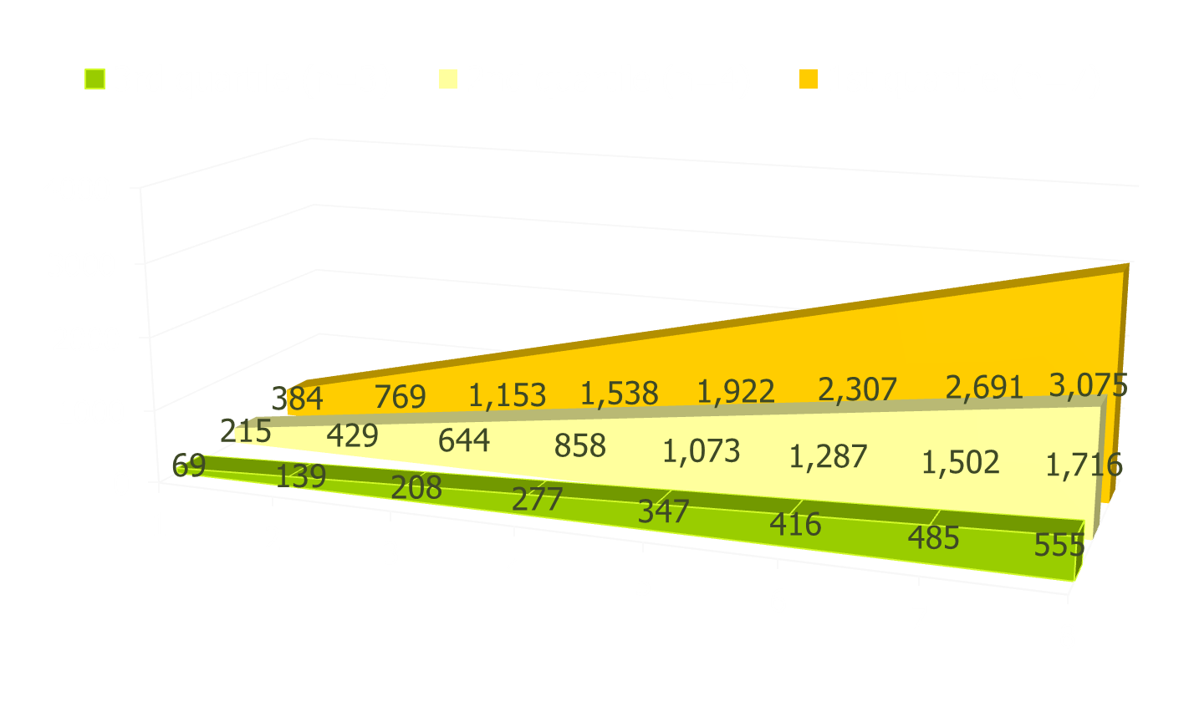
psychotherapy & deliberate practice
cumulative time spent in solitary practice over the first eight years of work as a psychotherapist

Slide 39
design & sequencing of training
ideally one monitors current performance & then designs specific individualized training activities: there is relevance here both for psychotherapists & clients.
Ericsson K. Anders. (2013). "The science of human excellence meets psychotherapy.” lecture at “Achieving clinical excellence conference.” May 17th, Amsterdam.

Slide 40
designing optimal level of practice
Ericsson K. Anders. (2013). "The science of human excellence meets psychotherapy.” lecture at “Achieving clinical excellence conference.” May 17th, Amsterdam.

Slide 41
research on developing expertise
clarify overall starting point and overall goal – an obvious example is an aim to improve the proportion of clients who get to “recovery”.
choose an important sub-goal that will be a good building block in reaching the overall goal.
again clarify one’s starting point and what the targeted sub-goal end state will look like.
deliberate practice of sub-goal building block
fast, accurate feedback, the challenge repeated many times, gradual incremental progress
select further building block sub-goals to work on
monitor progress to main over-arching goal

Slide 42
where should therapists focus?
common factors quality relationship, good goal agreement, confidence in methods
specific factors appropriate evidence based therapy, skilfully executed & supervised
Both camps can potentially make large gains in the results they achieve through better understanding and application of research on how individuals develop expertise – careful, measured assessment of one’s base-line; identification of key areas to work on; clarity about what better performance will look like; repeated, focused practice with rapid feedback; monitoring of whether performance improves & skilled supervision/mentoring

Slide 43
key points of this talk
psychotherapy’s current state: some reasons to be pleased
psychotherapy’s current state: some reasons to be worried
the major benefits we can achieve through balancing evidence-based practice with practice-based evidence
new insights from cross disciplinary research on how humans develop excellence

Slide 44
clearings in the clouds can help us choose the best directions
april 2011, lars-goran ost on lack of progress over four decades of cbt anxiety research
july 2012, michael lambert on ‘pseudoshrinks & supershrinks’
may 2013, anders ericsson on the development of excellence
these are exciting times: regular skilful monitoring of client progress & alliance combined with targeted, personally relevant deliberate practice looks one of the most encouraging new developments in many years.

Slide 45

let’s make our own roads!
© Copyright 2012, Erik Johansson

