Slide 1
session 8 – key points
‘nourishing’ relationships: ‘knowledge’ & ‘intelligence’
touch and sex
conflict and wisdom
‘attachment’ and other innate behavioural systems
continuing to work with overall social networks & the affect dyad exercise

Slide 2
course outline/our journey
values, self-determination
mindset, exercise & sleep
willpower, diet, dependencies
mindbus & coping responses
savouring & gratitude
work, strengths, expertise
roles, dunbar, needs, dyads
nourishing, conflict, wisdom
groups, weak ties, resonance
review & stepping forward

Slide 3
session 7 – key points
relationships are central for health & wellbeing
funeral speeches – goals for relationship roles
robin dunbar’s research & personal social networks
how are we doing & s-dt needs for relatedness
emotional intelligence, closeness, the affect dyad

Slide 4
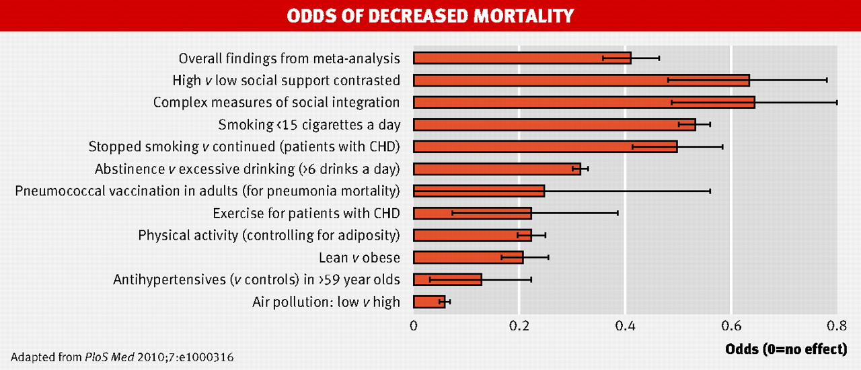
strong relationships improve survival as much as quitting smoking
.
Holt-Lunstad, J., et al. (2010). "Social relationships and mortality risk: a meta-analytic review.” PLoS Medicine 7(7): e1000316.
Chart taken from (2010) “Strong relationships improve survival as much as quitting smoking” BMJ 341: bmj.c4339

Slide 5
the importance of personality

Slide 6
three (+one) key psychological needs
autonomy – personal choice not compulsion by outside forces
competence – capable & effective not incompetent & inefficient
relatedness – regular emotional intimacy & shared activities not isolation & loneliness
beneficence – benevolence, being able to give not just self-centred
autonomy
competence
relatedness
beneficence
Reis, H. T., K. M. Sheldon, et al. (2000). Daily well-being: the role of autonomy, competence, and relatedness. Pers Soc Psychol Bull 26(4): 419-435. Sheldon, K. M., A. J. Elliot, et al. (2001). What is satisfying about satisfying events? Testing 10 candidate psychological needs. J Pers Soc Psychol 80(2): 325-39.

Slide 7
metaphors & mechanisms
mountain: - 5, 15, 50, 150 -
food: well balanced ‘diet’
garden: regular ‘watering’
music: how play together
attachment mentalising memory
mu-opioids orbital pfc capacity

Slide 8
personal social networks
Dunbar, R. (1998). "The social brain hypothesis." Evolutionary Anthropology 6(5): 178–190.
Stiller, J. & R. I. M. Dunbar (2007). "Perspective-taking and memory capacity predict social network size." Social Networks 29(1): 93-104.
Powell, J. L., et al. (2010). "Orbital prefrontal cortex volume correlates with social cognitive competence." Neuropsychologia 48: 3554-3562.
Dunbar, R. I. M. (2014). "The social brain: psych-ological underpinnings and implications for the structure of organizations." Current Directions in Psychological Science 23(2): 109-114.
Roberts, S. B. & R. I. Dunbar (2015). "Managing relationship decay: network, gender, and contextual effects." Human Nature 26: 426-450.
Mac Carron, P., et al. (2016). "Calling Dunbar's numbers." Social Networks 47: 151-155.
particular thanks for the extensive research on social networks conducted by Robin Dunbar, Oxford professor of evolutionary psychology, & colleagues

Slide 9
support clique/closest relationships
the ‘support clique’ are the people who one would turn to in times of extreme social, emotional or financial distress – note too ‘broaden & build’
on average there are about 5 people in the ‘support clique’ – with a range from 0 to 15 and sometimes 1 or 2 who are especially close - there may be a trade-off between overall numbers & individual closeness
these very close relationships involve considerable ongoing commitment of time, energy & emotion, but they ‘repay’ with major benefits for physical health, emotional resilience & overall wellbeing
‘support clique’ relationships are typically characterised by high emotional closeness, trust & frequency of contact
10 =
intensely close/intimate
fascinatingly ‘support clique’ numbers are limited not only by available time but also by ‘mentalising ability’ (perspective –taking competence) & the associated size of one’s orbital prefrontal cortex
0 =
emotionally neutral

Slide 10
sympathy group/good relationships
on average – including those in the ‘support clique’ - there are roughly 15 people in the ‘sympathy group’ – they are not so deeply close as those who are also in the ‘clique’ and are probably seen about monthly rather than approximately weekly for the ‘clique’
the ‘sympathy group’ are described as people who would be ‘devastated’ by the death of someone else in the group
typically there are about 3 x as many people in the ‘sympathy group’ as in the ‘support clique’ – and in both there are usually a considerably higher proportion of same sex contacts; people from large families may not have much time/space left in their sympathy group for non-family friends
emotional closeness changes & it takes time & regular contact to maintain – this is especially true for non-family friendships
10 =
intensely close/intimate
although both ‘sympathy group’ & ‘support clique’ numbers are limited by available time – the size of the latter is also dependent on mentalising ability (perspective –taking competence), while the former possibly depends more on memory capacity
0 =
emotionally neutral

Slide 11
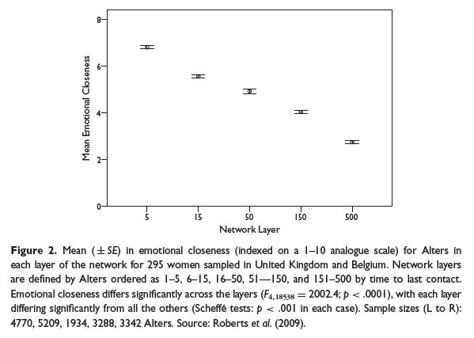
closeness varies by network layer
Sutcliffe, Dunbar et al, 2012

Slide 12
session 7 – key points
relationships are central for health & wellbeing
funeral speeches – goals for relationship roles
robin dunbar’s research & personal social networks
how are we doing & s-dt needs for relatedness
emotional intelligence, closeness, the affect dyad

Slide 13
session 8 – key points
‘nourishing’ relationships: ‘knowledge’ & ‘intelligence’
touch and sex
conflict and wisdom
‘attachment’ and other innate behavioural systems
continuing to work with overall social networks & the affect dyad exercise

Slide 14

the six ‘rules’ of friendship
stand up for them when they’re absent
share important news with each other
trust and confide in each other
volunteer help when it would be useful
provide emotional support for each other
try to make each other happy
the six rules were derived from 4 studies involving British, Italian, Hong Kong and Japanese participants
Argyle, M. & M. Henderson (1984). "The rules of friendship." Journal of Social and Personal Relationships 1(2): 211-237.

Slide 15
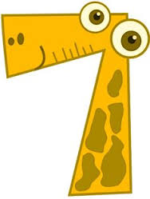
seven relationship competencies
communication
knowledge of partner
life skills
sex and romance
stress management
self-management
conflict resolution
Epstein, R., et al. (2013). "Which relationship skills count most?" Journal of Couple & Relationship Therapy 12(4): 297-313.
Epstein, R., et al. (2016). "Which Relationship Skills Count Most? A Large-Scale Replication." Journal of Couple & Relationship Therapy 15(4): 341-356.

Slide 16
knowledge of partner: knowing how to have fun with one’s partner, knowing about his/her preferences, caring about one’s partners hopes and dreams, etc
communication: knowing how to listen, sharing one’s thoughts & feelings honestly, refraining from criticizing, etc
life skills: managing money responsibly, exercising & staying fit, being able to find & keep a job, etc
sex and romance: inquiring & caring about how to please one’s partner sexually, setting aside time for intimacy, staying attractive for one’s partner, etc
stress management: using imagery techniques, thought management techniques, planning & organizational skills, etc
self-management: knowing one’s strengths & weaknesses, striving to overcome weaknesses, identifying/reaching goals, etc
conflict resolution: staying focused on the topic, staying focused on the present, being ready to forgive or apologize, etc
f>m f<m

Slide 17
some intriguing take-away points
knowledge and communication emerged as particularly helpful ways of nourishing close relationships – this is probably true for good friendships as well as for couples
knowledge of partner: knowing how to have fun with one’s partner, knowing about his/her preferences, caring about one’s partners hopes and dreams, etc
communication: knowing how to listen, sharing one’s thoughts & feelings honestly, refraining from criticizing, etc
knowledge: finding out about, remembering & referring to important aspects of the other’s life seems important and learnable; communication: crucial as well, although maybe we should be cautious on our self-assessment here

Slide 18

knowledge/interest seems crucial
know their hopes & dreams
know how to have a fun time with them
regularly ask about their tastes, preferences & passions
listen & remember when they tell me about their problems
remember their birthday and other special days
know all about their family

Slide 19
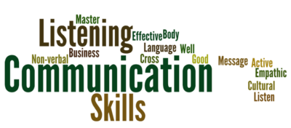
helpful communication central too
comfortable talking about my feelings
frequently encourage to express their views
always try to be honest
often ask for feedback
know how to describe my feelings accurately
praise & encourage far more often than criticize
try to make time for friendly conversation

Slide 20
session 8 – key points
‘nourishing’ relationships: ‘knowledge’ & ‘intelligence’
touch and sex
conflict and wisdom
‘attachment’ and other innate behavioural systems
continuing to work with overall social networks & the affect dyad exercise

Slide 21
interesting recent sex research
Muise, A., et al. (2019). "Broadening your horizons: Self-expanding activities promote desire and satisfaction in established romantic relationships." Journal of Personality and Social Psychology 116: 237-258.
Jackson, S. E., et al. (2019). "Decline in sexuality and wellbeing in older adults: A population-based study." Journal of Affective Disorders 245: 912-917.
Mark, K. P. and J. A. Lasslo (2018). "Maintaining sexual desire in long-term relationships: systematic review." The Journal of Sex Research 55(4-5): 563-581.
Maxwell, J. A., et al. (2017). "How implicit theories of sexuality shape sexual and relationship well-being." J Pers Soc Psychol 112(2): 238-279.
Debrot, A., et al. (2017). "More than just sex: affection mediates the association between sexual activity and well-being." Pers SocPsychol Bulletin 43(3): 287-299.
Arnocky, S., et al. (2017). "Altruism predicts mating success in humans." British Journal of Psychology 108(2): 416-435.
Twenge, J. M., et al. (2016). "Changes in American adults' reported same-sex sexual experiences and attitudes, 1973-2014." Arch Sex Behav 45(7): 1713-1730.
Lammers, J. and R. Imhoff (2016). "Power and sadomasochism: understanding the antecedents of a knotty relationship." Soc Psychol Personal Science 7(2): 142-148.
Muise, A., et al. (2015). "Sexual frequency predicts greater well-being, but more is not always better." Social psychological and personality
Joyal, C. C., et al. (2015). "What exactly Is an unusual sexual fantasy?" The Journal of Sexual Medicine 12(2): 328-340
Johnson, M. D., et al. (2015). "Skip the dishes? Not so fast! Sex and housework revisited." J Fam Psychol
Adam, F., et al. (2015). "Mindfulness skills are associated with female orgasm?" Sexual and Relationship Therapy 30(2): 256-267

Slide 22
interesting recent touch research
Triscoli, C., et al. (2019). "Depression predicts interpersonal problems partially through the attitude towards social touch." Journal of Affective Disorders 246: 234-240.
Sekerdej, M., et al. (2018). "Keeping in touch with context: Non-verbal behavior as a manifestation of communality and dominance." Journal of Nonverbal Behavior 42(3): 311-326.
Jakubiak, B. K. and B. C. Feeney (2017). "Affectionate touch to promote relational, psychological, and physical well-being in adulthood: A theoretical model and review of the research." Personality and Social Psychology Review 21(3): 228-252.
Nummenmaa, L., et al. (2016). "Social touch modulates endogenous mu-opioid system activity in humans." Neuroimage.
Jakubiak, B. K. and B. C. Feeney (2016). "A sense of security: touch promotes state attachment security." Social Psychological and Personality Science 7(7): 745-753.
Jakubiak, B. K. and B. C. Feeney (2016). "Keep in touch: The effects of imagined touch support on stress and exploration." Journal of Experimental Social Psychology.
Suvilehto, J. T., et al. (2015). "Topography of social touching depends on emotional bonds between humans." Proceedings of the National Academy of Sciences.
Robinson, K. J., et al. (2015). "When in doubt, reach out: touch Is a covert but effective mode of soliciting and providing social support." Social Psychological and Personality Science 6(7): 831-839.
Cohen, S., et al. (2015). "Does hugging provide stress-buffering social support? A study of susceptibility to upper respiratory infection and illness." Psychological Science 26(2): 135-147.

Slide 23
session 8 – key points
‘nourishing’ relationships: ‘knowledge’ & ‘intelligence’
touch and sex
conflict and wisdom
‘attachment’ and other innate behavioural systems
continuing to work with overall social networks & the affect dyad exercise

Slide 24

friendship & conflict
540 participants (only 112 were male)
all adults - 70% were aged between 18 & 38
363 were currently in a couple relationship
asked about ‘severe fallings out’ with people in their social network
last week/month/year
40% still not reconciled a year afterwards
conflicts with those who matter most to us in our personal social networks are surprisingly common
Dunbar, R. & A. Machin (2014). "Sex differences in relationship conflict and reconciliation." Journal of Evolutionary Psychology 12(2-4): 109-133.

Slide 25
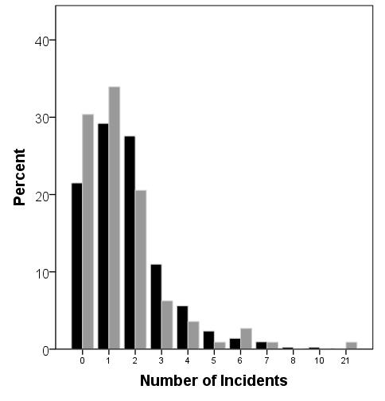
frequency of ‘severe falling out’
women: black columns
men: grey
columns
average of 1.67 episodes per person, but a high proportion were recent suggesting an underestimate for last year
Dunbar & Machin, 2014

Slide 26
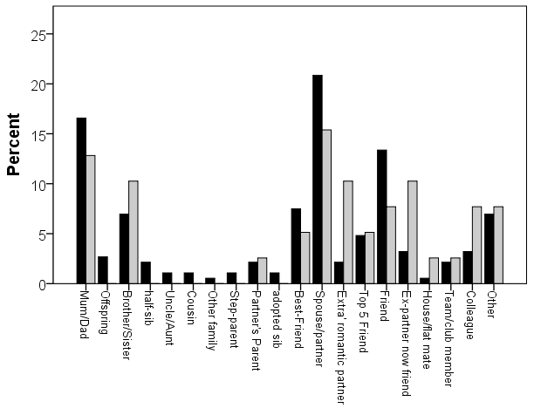
which relationships involved
women black,
men grey

Slide 27
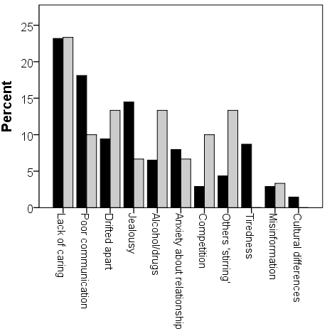
cause of ‘severe falling out’
women: black columns
men: grey
columns
cause was selected from a list of 14 possible choices
Dunbar & Machin, 2014

Slide 28
five principles of couples work
Andrew Christensen ‘A unified
‘protocol for couple therapy’
emphasize strengths & grow positive behaviours
modify emotion-driven maladaptive interactions
reasons for initial attraction to each other; assess & feedback strengths; encouragement of positive behaviour; learning from successful interactions; vulnerability behind demands & hostility
therapists may highlight & interrupt these patterns in session; at home, ‘time-outs’, mental contrasting & implementation intentions can all have a part to play
shared, non-blaming
dyadic, understanding
note importance of identifying & changing couples’ key distress-producing cause-effect chains
D: Differences
E: Emotional
sensitivities
E: External
circumstances
P: Patterns of
communication
cooperatively arrived at DEEP ‘reappraisal’: may involve an understanding that both partners are trying to meet valid needs but that how they’re doing this is unhelpfully coloured by their pasts
develop more adaptive communication skills
‘elephants’: problem-solving and intimacy
helping speakers become more ‘self-focused’ (less blaming of others, more disclosing own emotions & vulnerability); helping listeners become more ‘other focused’ (body language, standing ‘in the other’s shoes’, summarizing)
at the right time, it’s likely to be important to open up about any of a variety of potentially important avoided ‘elephant in the room’ topics; this can allow constructive joint problem-solving & deepen understanding & closeness

Slide 29
situated wise reasoning scale
mountain: - 5, 15, 50, 150 -
food: well balanced ‘diet’
garden: regular ‘watering’
music: how play together
attachment mentalising memory
mu-opioids orbital pfc capacity

Slide 30
session 8 – key points
‘nourishing’ relationships: ‘knowledge’ & ‘intelligence’
touch and sex
conflict and wisdom
‘attachment’ and other innate behavioural systems
continuing to work with overall social networks & the affect dyad exercise

Slide 31

attachment: care-seeking situations

Slide 32
attachment: care-seeking situations

Slide 33
other ‘intrinsic’ behavioural systems
care-seeking
care-giving
exploration
sex
power
about right?
too hot?
too cold?

Slide 34
session 8 – key points
‘nourishing’ relationships: ‘knowledge’ & ‘intelligence’
touch and sex
conflict and wisdom
‘attachment’ and other innate behavioural systems
continuing to work with overall social networks & the affect dyad exercise

Slide 35
personal social networks
Dunbar, R. (1998). "The social brain hypothesis." Evolutionary Anthropology 6(5): 178–190.
Stiller, J. & R. I. M. Dunbar (2007). "Perspective-taking and memory capacity predict social network size." Social Networks 29(1): 93-104.
Powell, J. L., et al. (2010). "Orbital prefrontal cortex volume correlates with social cognitive competence." Neuropsychologia 48: 3554-3562.
Dunbar, R. I. M. (2014). "The social brain: psych-ological underpinnings and implications for the structure of organizations." Current Directions in Psychological Science 23(2): 109-114.
Roberts, S. B. & R. I. Dunbar (2015). "Managing relationship decay: network, gender, and contextual effects." Human Nature 26: 426-450.
Mac Carron, P., et al. (2016). "Calling Dunbar's numbers." Social Networks 47: 151-155.
particular thanks for the extensive research on social networks conducted by Robin Dunbar, Oxford professor of evolutionary psychology, & colleagues

Slide 36
sympathy group/good relationships
on average – including those in the ‘support clique’ - there are roughly 15 people in the ‘sympathy group’ – they are not so deeply close as those who are also in the ‘clique’ and are probably seen about monthly rather than approximately weekly for the ‘clique’
the ‘sympathy group’ are described as people who would be ‘devastated’ by the death of someone else in the group
typically there are about 3 x as many people in the ‘sympathy group’ as in the ‘support clique’ – and in both there are usually a considerably higher proportion of same sex contacts; people from large families may not have much time/space left in their sympathy group for non-family friends
emotional closeness changes & it takes time & regular contact to maintain – this is especially true for non-family friendships
10 =
intensely close/intimate
although both ‘sympathy group’ & ‘support clique’ numbers are limited by available time – the size of the latter is also dependent on mentalising ability (perspective –taking competence), while the former possibly depends more on memory capacity
0 =
emotionally neutral

Slide 37
affinity groups & active networks
on average there are about 150 people in a personal full ‘active network’ – with a natural range of approximately 100-250; it correlates with pre-industrial village size & earlier tribal size; the active network may well serve both territorial & mate-access functions
one’s full ‘active network’ is made up mostly of ‘acquaintances’ - all the people with whom one has a ‘personalized’ relationship and who one wants to maintain contact with
successive network layers increase in numbers by a factor of about 3, and tend to involve relationships that demand less time investment to maintain & that are less emotionally close – however different layers respond to different needs
the smaller – approximately 50 sized – affinity or foraging group probably primarily has an anti-predation function
10 =
intensely close/intimate
social identity theory (haslam, cruwys, et al) highlights the considerable health gains obtainable through identification & participation with a variety of groups, that may be populated by acquaintances rather than friends
0 =
emotionally neutral

Slide 38
session 8 – key points
‘nourishing’ relationships: ‘knowledge’ & ‘intelligence’
touch and sex
conflict and wisdom
‘attachment’ and other innate behavioural systems
continuing to work with overall social networks & the affect dyad exercise

