Slide 1
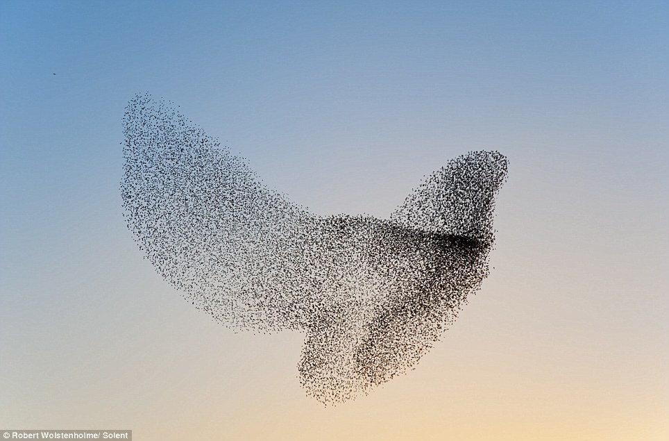
do birds of a feather flock together?
surveyed: 226 UK working-age adults (115 males, 111 females; mean age 43, SD=10.8
asked to identify a couple of friends – 1 male & 1 female (not family) – in each of 3 ‘layers’
previous research has shown network layer tends to map onto frequency of contact
this study used layer 2 (sympathy) monthly; layer 4 (active social network) yearly; and layer 5 (total network) contacted every few years
Curry, O. and R. I. M. Dunbar (2013). "Do birds of a feather flock together?" Human Nature 24(3): 336-347.

Slide 2
asked which of 22 similarities they shared
asked “which of the following are true of your relationship?” share political views; share religious beliefs; share moral beliefs; share hobbies & interests; have the same friends; have similar personalities; from the same area; from the same school/college/university; work together/same workplace; speak the same language/dialect; share a sense of humor; support same sports team; like similar music; have similar fashion sense; are of the same ethnic group; have the same occupation; are members of the same club/association; are of the same class/socioeconomic status; have similar incomes; have similar levels of education/intelligence; are of the same generation/similar age; have the same sexual orientation (e.g. homosexual/heterosexual)

Slide 3
similarity & emotional closeness declined across the layers
similarity score ranged from 0 to 22
emotional closeness ranged from 1 (not at all close) to 10 ( extremely close)
 | layer 2 | layer 4 | layer 5
similarity | 10.5 | 8.6 | 7.6
closeness | 4.8 | 3.9 | 3.2

Slide 4
