Slide 1

6 factors usually shared across all 3 personal network layers surveyed
these 6 commonly shared factors are predictable & possibly a bit concerning
speak the same language/dialect
same sexual orientation
same ethnic group
same generation/similar age
same class/socioeconomic status
similar level of intelligence/education

Slide 2
6 factors (plus contact frequency) most distin- -guished between layers
“the final model for emotional closeness shows 6 variables plus layer make unique significant positive contributions”
sense of humor
moral beliefs
hobbies/interests
similar personalities
taste in music
from same area

Slide 3
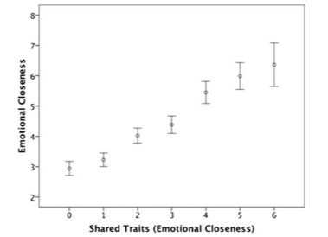
6 factor similarity tracks closeness

Slide 4
maybe these are useful indicators for potential future friendships?
6 factors usually shared across all 3 network layers surveyed: language/dialect, sexual orientation, ethnic group, generation/age, class/socioeconomic status, intelligence/education
6 factors (& contact frequency) distinguishing most between more or less emotional closeness: similar sense of humor, moral beliefs, hobbies/interests, personalities, taste in music, location

