Slide 1



therapeutic drift: black heresy or red herring?
Dr James Hawkins
www.goodmedicine.org.uk

Slide 2

key points of this talk
black heresy: what is therapeutic drift and does it really matter?
red herring: does it distract us from much more major problems?
four suggestions for ways out of therapy’s rather shocking impasse

Slide 3
what is therapist drift?
“Therapist drift occurs when clinicians fail to deliver the optimum evidence-based treatment despite having the necessary tools, and is an important factor in why those therapies are commonly less effective than they should be in routine clinical practice”
Waller, G. and H. Turner (2016). "Therapist drift redux: Why well-meaning clinicians fail to deliver evidence-based therapy, & how to get back on track." Behaviour Research and Therapy 77: 129-137.

Slide 4
does ‘therapist drift’ matter?
“Therapist drift … is an important factor in why … therapies are commonly less effective than they should be in routine clinical practice” Waller & Turner (2016)
this claim suggests that:
high therapist adherence to specific therapy models is strongly linked to good outcome
high therapist competence in specific therapy techniques is strongly linked to good outcome
there will be a tendency for outcomes to worsen the longer therapists are in practice

Slide 5
does ‘therapist drift’ matter?
adherence, competence & outcome:
Webb, C. A., et al. (2010). "Therapist adherence/competence and treatment outcome: A meta-analytic review." J Consult Clin Psy 78: 200-211.
“The literature search identified 36 studies … neither the mean weighted adherence-outcome (r = .02) nor competence-outcome (r = .07) effect size estimates were found to be significantly different from zero.”

Slide 6
does ‘therapist drift’ matter?
adherence, competence & outcome:
Weck, F., et al. (2015). "Treatment failure in CBT: therapeutic alliance as a precondition for an adherent and competent implementation of techniques." Br J Clin Psychol 54(1): 91-108.
“higher therapists' competence was found to affect treatment outcome positively, only mediated by therapeutic alliance. Higher … adherence affected treatment outcome positively, only mediated by … competence-alliance.”

Slide 7
does ‘therapist drift’ matter?
adherence, competence & outcome:
Tschuschke, V., et al. (2015). "The role of therapists' treatment adherence, professional experience, therapeutic alliance … treatment outcome in eight different psychotherapy approaches." Psychother Res 25(4): 420-434.
“There was no statistically significant association between … the degree of therapists' treatment fidelity and the treatment outcome.”

Slide 8
does ‘therapist drift’ matter?
“Therapist drift … is an important factor in why … therapies are commonly less effective than they should be in routine clinical practice” Waller & Turner (2016)
this claim suggests that:
high therapist adherence and competence to specific models are strongly linked to outcome
how about the suggestion that:
there will be a tendency for outcomes to worsen the longer therapists are in practice

Slide 9
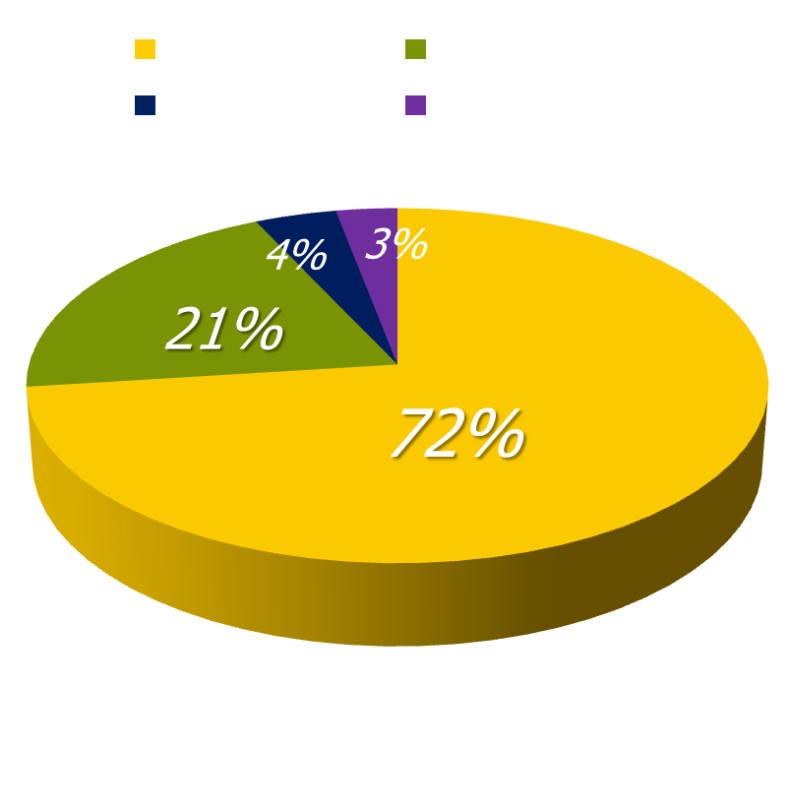
effects of increasing experience
systematic review of 62 studies published between 1966 and 2004 looking at physician experience effects
73% found increasing experience associated with decreasing performance for some (21%) or all (52%) outcomes assessed
there seems to be an inverse relationship between years of experience and the quality of care that is provided
Choudhry, N. K., et al. (2005). "Systematic review: The relationship between clinical experience and quality of health care." Ann Intern Med 142(4): 260-273.

Slide 10
effects of increasing experience
Researchers examined the association between experience and mortality rates for surgeons performing cardiac artery bypass grafting. After adjust-ment for both patient and doctor variables, they found that surgeons who had been in practice longer had higher operative mortality rates (P<0.001).
Hartz A. J., et al. (1999). “Prestige of training programs and experience of bypass surgeons as factors in adjusted patient mortality rates.” Med Care. 37:93-103.
Mortality rates were analyzed for 39,007 hospitalized patients with acute myo-cardial infarction managed by 4,546 cardiologists, internists & family pract-itioners. After controlling for patient’s probability of death, hospital location & practice environment, physician specialty, board certification & the volume of patients seen, the researchers found a 0.5% increase in mortality for every year since the treating physician had graduated from medical school.
Norcini, J. J., et al. (2000). "Certification and specialization: Do they matter in the outcome of acute myocardial infarction?" Academic Medicine 75(12): 1193-1198.

Slide 11
effects of increasing experience not so relevant for psychotherapy
Goldberg, S. B., et al. (2016). "Do psychotherapists improve with time and experience? A longitudinal analysis of outcomes." J Couns Psychol 63: 1-11.
“Therapists (170) achieved outcomes comparable with benchmarks from clinical trials. However, a very small but statistically significant change in outcome was detected indicating that on the whole, therapists' patient prepost d tended to diminish as experience (time mean<5yr or cases) increases … Further, therapists were shown to vary significantly across time, with some therapists showing improve-ment despite the overall tendency for outcomes to decline.”
Hill , C. E. and S. Knox (2013). “Training and supervision in psychotherapy”
in M. J. Lambert (ed) “Handbook of psychotherapy & behavior change 6th ed”
“Two recent analyses of very large numbers of therapists (652) perhaps provide the most definitive evidence about therapist experience … In summary ... more recent studies involving large numbers of therapists showing no effects.”

Slide 12
effects of increasing experience not so relevant for psychotherapy
Wampold, B. E. and G. S. Brown (2005). "Estimating variability in outcomes attributable to therapists: a naturalistic study of outcomes in managed care." J Consult Clin Psychol 73(5): 914-923.
“the authors analyzed the outcomes of 6,146 patients seen by approximately 581 therapists in the context of managed care … therapist age, gender, experience, and professional degree accounted for little of the variability in outcomes.”
Okiishi, J. C., M. J. Lambert, et al. (2006). "An analysis of therapist treatment effects: Toward providing feedback to individual therapists on their clients' psychotherapy outcome." Journal of Clinical Psychology 62(9): 1157-1172
“data collected on over 5,000 clients seen by 71 therapists over a 6-year period … client recovery could not be shown to be a function of differences in therapist gender, professional training, professional experience, or theoretical orientation.”

