Slide 1
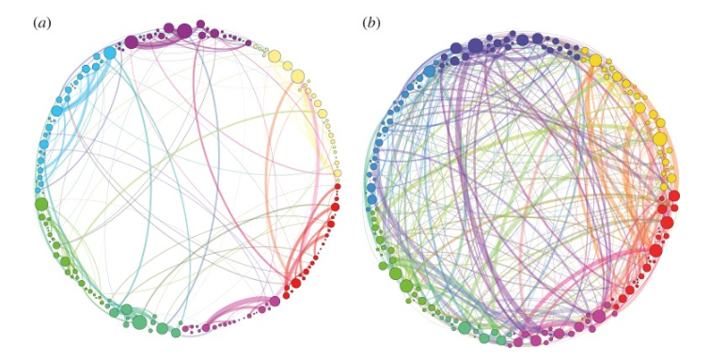
what would it be helpful for counsellors to know about psychedelics?
brain on placebo
brain on psilocybin
Petri G. et al. (2014)
Pastoral Foundation
6th August 2023 with
Dr James Hawkins
“Remedicalising psilocybin and related drugs is the most interesting project in contemporary psychiatry”
Guy Goodwin, Oxford Emeritus Professor of Psychiatry

